Slide 1

Eaquals | Inhouse Training Seminar
Targeting Fossilised Errors
Developed by Claire Averis for St Giles London Central

Slide 2
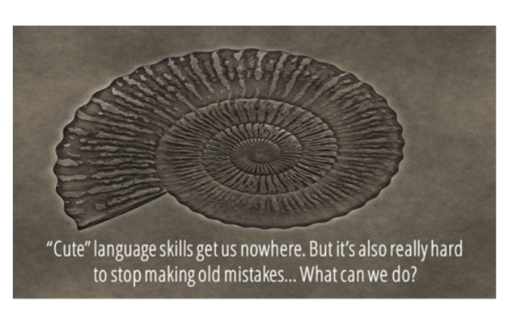
.... to target fossilised errors?

Slide 3

Targeting Fossilised Errors
how we can prevent errors commonly made at A1 and A2 from becoming fossilised
eradicating fossilised errors at B1+

Slide 4

Cute language skills?
Do many of our students just want to settle for "cute" language skills?
How to Fix Fossilized Errors (IATEFL) Jaime Miller 2016
https://www.youtube.com/watch?v=o3sYW_DBi4E (00:56 - 02:02)

Slide 5
Typical Fossilised Errors
What are the kind of errors that students make at A1 and A2 that should be eradicated by the time they reach B1+?

Slide 6
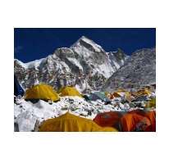
Definition
According to Scott Thornbury,
"fossilization – almost by definition – implies the end of the road.... if a non-standard language form becomes fixed, it is fossilized, and there is no way of rescuing it..... [However, all] language learners fossilize at some point – that is to say their 'interlanguage' stabilizes at a point short of native-speaker proficiency. Some fossilize around about beginner level; others make it to advanced – but eventually there is a trade-off between the effort that would be required to top up the system, and their current degree of satisfaction at their communicative effectiveness. Unlike mountaineers, most language learners settle for the view from Base Camp. “
http://www.onestopenglish.com/methodology/ask-the-experts/methodology-questions/methodology-fossilized-errors/146396.article

Slide 7
Types of Fossilised Errors
How do you deal with fossilized errors and help students improve their
accuracy? #ELTchat Summary 23/02/2011 by Michelle Worgan
Something:
known to be wrong but made constantly despite correction
can be corrected when highlighted but often still made
from force of habit - no longer aware they are making it
repeated so often that it sounds right to the learner
learnt wrongly and now needs to be "unlearnt"
based in L1 interference and made by many speakers
teachers may not “hear” after a number of years teaching in a particular context and therefore goes uncorrected
In small groups, take 2 minutes to think of examples of these that you have encountered this week.

Slide 8
Causes of Fossilisation
How do you deal with fossilized errors and help students improve their
accuracy? #ELTchat Summary 23/02/2011 by Michelle Worgan
Do you agree? Which have a bigger impact?
L1 interference - natural feature of interlanguage development
Lack of correction
Method of instruction
Previous stages of learning (especially with older students).
Realisation that despite making a mistake they are still understood
Lack of motivation to correct oneself
Lack of noticing and discovery and too much presentation, meaning students don’t own the language.
Lack of learner autonomy – reliance on correction by teacher.
Biological, social-affective, cultural, pedagogical, cognitive and environmental perspectives of a language
Is any of this true for the fossilised errors you mentioned?

Slide 9
Teacher Considerations
How do you deal with fossilized errors and help students improve their
accuracy? #ELTchat Summary 23/02/2011 by Michelle Worgan
If students communicate meaning, are fossilized errors important?
It is impossible to correct everything – deal with what affects meaning most.
Correcting every error can be demotivating.
But:
Students [generally] love being corrected and prefer teachers that do so.
Maybe:
Focus should be on common and impeding errors.
Students should reflect on and play with their mistakes.
More self-correction should be fostered.
Wider considerations:
Do fossilized errors lead to international English? If so, is there anything wrong with making these errors?
How far should the teacher go?
How far should the teacher go?

Slide 10
To correct or not to correct?
http://eltnotebook.blogspot.co.uk/2007/04/deciding-what-and-when-to-correct.html
There are also students who want constant correction and others don’t want it at all. Correct too much and you annoy the second group, don’t correct enough and you lose the confidence of the first, who feel that you are not “teaching” them.
If the error occurred during a controlled practice, it would be counterproductive not to correct it immediately.
An error should be corrected if there is "the risk that it becomes fossilised".

Slide 11
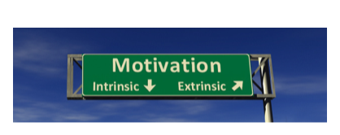
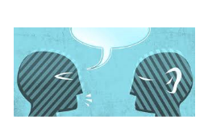
Internal Motivation
According to Scott Thornbury, in order to target fossilised errors students need to have internal motivation:
Social:
A learner living in an English-speaking culture might want to stop sounding like a foreigner. (But many learners are not going to use their English with many native-speakers, and very few will be planning to integrate into an English-speaking culture.)
Intelligibility:
If the learner gets consistent messages that they are unintelligible, they may take steps to move their interlanguage along a step or two.

Slide 12
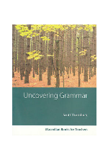
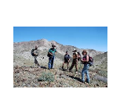
Guidance for Teachers:
Scott Thornbury suggests teachers can/should:
give students learners clear messages about their intelligibility, eg pretending they don't understand.
set grammar interpretation exercises which draw attention to otherwise unnoticed, and often unnoticeable, distinctions in the grammar. (Uncovering Grammar)
nip fossilisation in the bud with little nudges and corrections while students are in full flow (on-the-spot and delayed error correction)
keep the learner in the right state of anxiety (Peter Skehan)
But in the end you have to ask yourself – and they have to ask themselves – is it worth it? Life is too short to aim for perfection. The view from half-way up may be just fine.

Slide 13
Practical suggestions
How do you deal with fossilized errors and help students improve their accuracy?
#ELTchat Summary 23/02/2011 by Michelle Worgan
Say: “Whaaaaat? - That’s not English/No one in the UK is going to understand what that means.”
Give students a funny look when they make a fossilized error – they will realise something is wrong and
correct themselves!
Use humour to point out errors e.g. “I talk to the phone”, act out talking to your phone!
Drills
Playing games with individual mistakes or common errors.
Focus on one error at a time, stopping students and having them correct it before moving on.
Explain the consequences of mistakes, especially embarrassing ones.
Create better noticing opportunities.
Mixing correct and incorrect sentences on the board and asking students to spot those with errors.
More self-correction and peer correction, eg recording students to correct own or peer’s errors, maybe going through tapescript. (Recording students can actually make students more careful in the first place.)
Would they work for the fossilised errors you mentioned?

Slide 14
Practical Suggestions
What about these suggestions?
Personalized “fossil” diaries where students record their particular errors
Students could observe themselves [or even each other] out of class and report back on their usage.
Teacher could compile a list of each students' fossilised errors
What do you think?
How could you develop this?

Slide 15
Jeremy Harmer’s Suggestions
What does Jeremy Harmer suggest? (from 00:30)
https://www.youtube.com/watch?v=l1cz-8n9DGk

Slide 16
Jeremy Harmer’s Suggestions
critical awareness in students
compare examples of good writing with student's writing
How could you write this differently?
students to write a list of things to evaluate - have they met their own criteria?
Students to collect a list of their typical errors from teacher and work out when they've made them

Slide 17
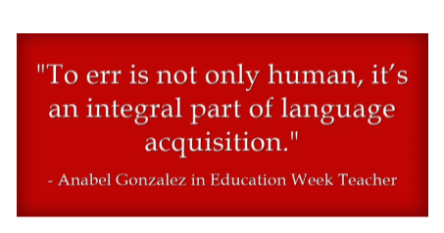
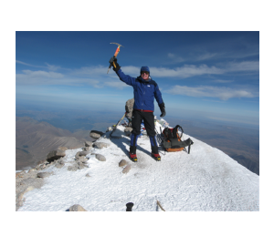
Summary
We want our students to be intelligible and taken seriously with their English
Prevention is better than defossilization (an apple a day…)
Teachers have to be very proactive and inventive with error correction and prevention
Students must be invested in correcting errors and teachers need to facilitate this

Slide 18
Advice for your students
What advice can you offer your students regarding fossilization and avoiding being "cute"? https://www.youtube.com/watch?v=4Y59UCsHdRU

Slide 19
Thank you to for the time & effort in preparing these materials for the Eaquals network.
#eaquals #eaqualsfamily

