Slide 1
Action Research: Overcoming the challenges
Aidan Holland
Senior Teacher Professional Development
British Council, Madrid
Notes:
Introduction

Slide 2
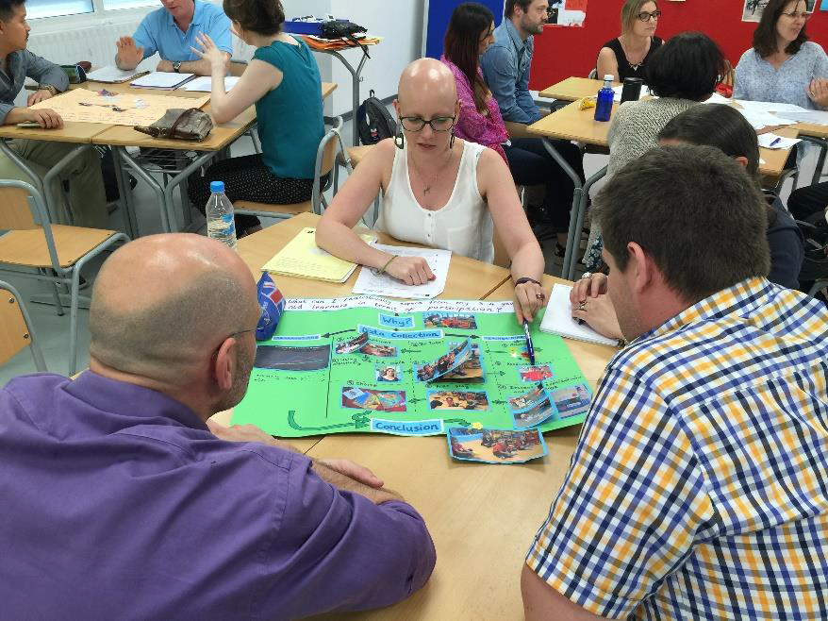
Action research
Discuss what you understand by the term Action Research with a partner or in a small group.
Teacher centred
Systematic
Understanding the process
Empowering
Notes:
Participants discuss what they understand Action Research is. Do a brief feedback as a group. Action Research:
-seeks an in-depth understanding of complex situations e.g. teaching, nursing (involving multiple variable factors)
-looks for practical (and local) solutions to (individual) teachers problems
-is a reaction to the positivist paradigm in which it is thought that generalizable solutions are the way forwards. This approach is relevant to a field such as medicine, but is not as successful in teaching.
-Empowering. Teachers take responsibility for their own learning, rather than being passive recipients of training sessions (this is not to say the training sessions are not valuable!).

Slide 3
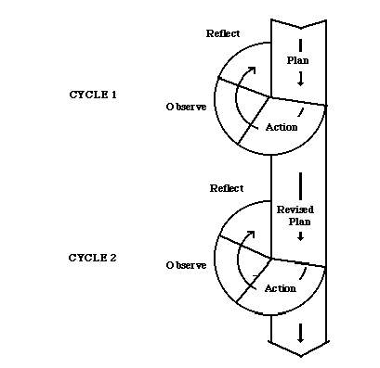
The Action Research Cycle
rhizome.org
Notes:
How do we conduct AR? Revise the AR cycle. Stress that this is the classic model that can spiral off in a multitude of directions. It is important for teachers not to stick too rigidly to this as the stages will overlap.
Explain in terms of Lisa’s research project:
Plan: Lisa identified a dilemma she had been having in class (encouraging students to read more). She read about the benefits of extensive reading and thought of a way to encourage students to do this (read short stories and articles, logging their reactions in a student diary). Based on a previous experience doing AR, she gauged students’ reading preferences in order to ensure they would engage with the topics.
Act: Lisa prepared a number of reading tasks for students and planned out her time so that students completed their diaries in class.
Observe: Students engaged in the reading and completed their reading diaries. She later decided to include a focus on structure to show students how reading could impact positively on their language ability.
Reflect: Lisa engaged in reflections with her colleagues every couple of weeks about how it was going to work towards deciding whether this was a successful intervention.

Slide 4
Features of Action Research
Reflecting effectively (reflection-in-action and reflection-on-action)
Formulating the question
Gathering data (triangulating)
Notes:
These are areas which I have found people have particular problems with. Explain that you will present some ideas for dealing with them more effectively.
Firstly, participants should do ACTIVITY 2 – where they have to think about the different types of reflection. AR should push you to reflect on a deeper level. This is why it is better to do it in groups.

Slide 5
Writing your question
What improves motivation in my class?
Can group work be extended in my classroom?
How will using electronic dictionaries lead to higher test scores in my students’ writing?
How will observation of my students carrying out listening tasks increase my understanding of how best to develop their listening skills?
What is task-based language learning (TBL)?
How can I develop students’ reading skills by using a phonics only approach?
Notes:
The questions are all flawed in some way. Discuss how they are flawed then check answers in Activity 3 on handout.

Slide 6
Collecting Data - Triangulation
Consulting the literature
Interventions (e.g. using readers, recording students)
Questionnaires/interviews
Diaries (teacher or student)
Observation
Notes:
It’s important to consult the literature to an extent in order that your question hasn’t already been answered.
The ways in which you collect data must be carefully chosen in order to answer the question. Using observation, for example to investigate students’ listening strategies, would not be an appropriate technique.
Explain that some AR involves an intervention, e.g. Lisa’s reading project, Your recording project
Others involve questionnaires/interviews.

Slide 7
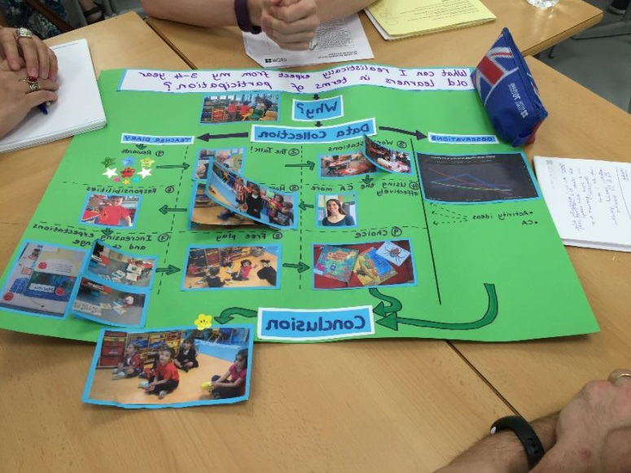
The Action Research Programme at Somosaguas
January 11/12 – Setting up sessions (2 hours)
February to May – Group meetings every fortnight (7 hours)
May/June – Swap shops (3 hours)
Total: 12 hours
Notes:
Explain how Action Research is set up at Somosaguas and what your role in it is.
Time
Session every fortnight
Teachers asked to work in groups and investigate similar topics (reporting back)
Lots of support at beginning to choose area, refine question (intervention?) and select data gathering techniques
Ends – swap shops (and write ups). Some teachers use knowledge to turn into sessions.

Slide 8
An example…
How can I help my J3 students understand the contribution that reading makes to their language learning and encourage them to read more in English?
© Pixabay
Why did she choose to investigate this area?
What materials did she develop?
What did she gain from doing the project?
Notes:
Watch the clip and answer the questions.

Slide 9
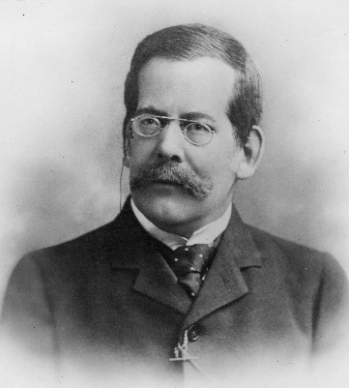
How can I help my J3 students understand the contribution that reading makes to their language learning and encourage them to read more in English?
Questionnaire to gauge students’ reactions to the reading project
?
Reading Diary
Questionnaire to gauge students’ reading preferences
?
Reading Sources:
LE Kids
Graded Readers
Brit Lit
COLLATED RESPONSES TO TEXTS
Notes:
Point out from Lisa’s comments that she had had 2 main problems in the previous year:
Not asking students about their interests.
Forming a vague question.

Slide 10
Focus 1
To what extent is Lisa’s investigation grounded in theory?
Not at all
Heavily
2. To what extent did she attempt to be systematic in her data collection and analysis?
Not at all
A lot
3. To what extent do you think her project was doable in the time given?
Not at all
Extremely
Notes:
As feedback, ask participants to first discuss the questions and then write their answers on a post it note.
Feedback on slide.
Discuss:
The necessity of doing a bit of reading about your subject area. Sometimes you can find the answer to your questions just by doing this.
Being systematic and trying to gather data from multiple sources is key. Lisa could also have interviewed students or tested them.
It is important not to bite off more than you can chew. Action Research is what you make it, it is best to start off small.

Slide 11
Focus 1
To what extent is Lisa’s investigation grounded in theory?
Not at all
Heavily
2. To what extent did she attempt to be systematic in her data collection and analysis?
Not at all
A lot
3. To what extent do you think her project was doable in the time given?
Not at all
Extremely
Notes:
As feedback, ask participants to first discuss the questions and then write their answers on a post it note.
Feedback on slide.
Discuss:
The necessity of doing a bit of reading about your subject area. Sometimes you can find the answer to your questions just by doing this.
Being systematic and trying to gather data from multiple sources is key. Lisa could also have interviewed students or tested them.
It is important not to bite off more than you can chew. Action Research is what you make it, it is best to start off small.

Slide 12
What can I realistically expect from my 3-4 year old learners in terms of participation? What techniques can I use to promote student participation in class activities?

Slide 13
Observations
Beginning
Middle
End
Notes:
Observation can be of the teacher or students, by the teacher themself (self-observation) or by a manager/peer.
As part of Hayley’s Action Research Project entitled What can I realistically expect from my 3-4 year old learners in terms of participation? She conducted a series of peer observations in which she used a simple observation tool whereby she noted the instances of what she considered off-task behaviour in order to begin to answer her question.

Slide 14
What can I realistically expect from my 3-4 year old learners in terms of participation?
Notes:
The project developed from there into the different types of tasks which were more effective in terms of EY participation.

Slide 15
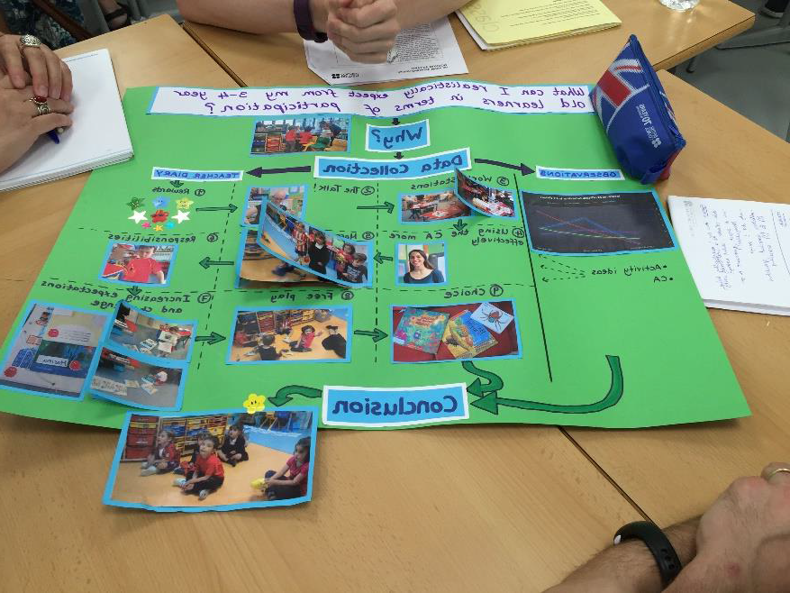
What techniques can I use to promote student participation in class activities?

Slide 16
What data collection tools would be relevant to answer these questions:
I want my classroom to be more learner-centred. How much talking do I do compared with my students?
My students seem to have difficulty with listening but I don’t know much about how they approach it. What strategies do your students use during listening comprehension activities?
Notes:
Good to make a observation tool for this. Then read to extend the project.
This would lend itself better to questionnaires/interviews asking students what they are thinking when they are doing a listening task.

Slide 17
Advice for conducting AR
Motivation
Regular opportunities to collaborate
Informed Support
Sufficiently long course duration
Outcome
© Pixabay

Slide 19
aidan.holland@britishcouncil.es

