Slide 1
Teachers´ Beliefs in Times of Shifting Paradigms
A Mixed Methods Investigation into Language Teachers’ Beliefs and Attitudes towards Curricular Reform in Ireland
Elisabeth Butler
#eaquals19madrid
Notes:
Good Afternoon and thank you for joining me here today. My name is Elisabeth Butler and I am joining you from my adopted home country of Ireland where I have lived for more than twenty years. Anyone here from Ireland today? …I am originally from Austria ..anyone from Austria? …Very good. This is my first Eaquals conference and I am delighted to be here today. I am presenting to you the findings from my recent study of language teachers’ beliefs about language learning and their attitude towards curricular reform.

Slide 2
Structure of the Presentation
Context
Why investigate Teacher Beliefs?
Presenting of the Study
Implications
Notes:
So to begin I will give you a brief outline of what I am going to talk about today. I’m going to begin by telling you a little bit about my reason for carrying out this research and what exactly I was trying to find out.
We will then look at both the international as well as the local context for this study before moving on the rationale behind investigating teachers’ beliefs.
Then I will present key aspects of how I carried out my research before concluding with the implications of my findings for the Irish context as well as the wider context of language teaching
(Fives and Buehl, 2016)

Slide 3
Background: The Irish Context
Post-Primary
Tertiary
Primary
4 years – 12 years
12years – 18 years
> 18 years
Compulsory Education
Junior Certificate Examination:
externally administered and assessed
Leaving Certificate Examination:
externally administered and assessed and used to calculate points for access to third level
Notes:
For those of you unfamiliar with the Irish education system, Ireland is currently undergoing the most significant educational reform in its history. Students in the Republic of Ireland typically attend post-primary schools between the ages of 12-18, their time in school divided into junior and senior cycle. Each cycle ends with an externally administered and assessed high-stakes examination. These examinations are strongly embedded in the irish culture with questions typically discussed on national media! The reform proposed to abolish the junior certificate and replace it with ongoing continuous assessment, which was met with resistance from trade unions and led to a watered-down version outlined in the next slide.
Ireland is currently undergoing the most significant educational reform of lower secondary education, which puts “the student at the centre of the learning experience and allows a wider range of skills to be properly assessed”. For those of you not familiar with the Irish education system, it is a system which places huge value in externally set and assessed examinations.
In 2016 I started to work for a teacher support service designing and facilitating in-service teacher training events to implement a national curricular reform. I was struck by the level of resistance to a curriculum which was grounded in communicative principles as well as bringing language teaching in Ireland in line with the common European framework of reference for the first time.

Slide 4
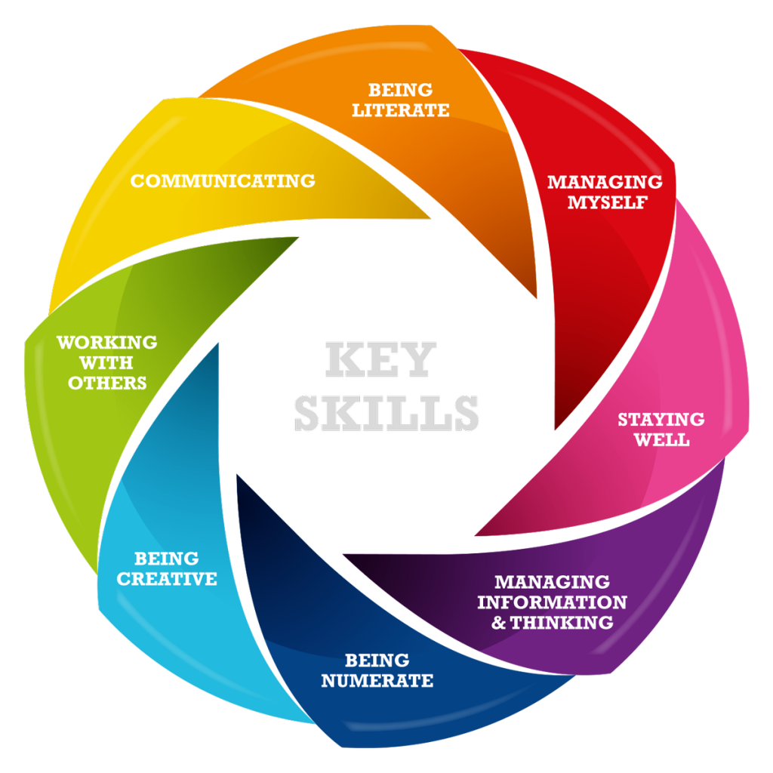
Irish Reform and the wider International Context
Notes:
In the context of modern foreign languages our new curriculum is broadly aligned to A1-A2 level of the CEFR as well as key skills very similar to what Herbert was speaking about this morning. Our new curiculume is based on principles and key skills which are very much in line with 21st century key skills Despite this clear link with international best practice teachers remained sceptical and resisted the changed.
In 2016 I began to work for the teacher support service charged with implementing this reform and I began to form my own hypothesis with regards to the reasons for teachers’ negative attitudes towards this reform. As I was at the time in the middle of my Masters in Applied Linguistics, I decided to research the link between teachers’ beliefs about how languages are learned, their teaching approach and their attitute towards reform.

Slide 5
Reformed Assessment Structure for Modern Foreign Languages in Junior Cycle
The new curriculum “…places the student at the centre of the learning process and envisages a modernised curriculum across all subjects. It allows for new ways of learning and a broader range of skills to be properly assessed.”
( Framework for Junior Cycle, 2015, p 2)
ONGOING ASSESSMENT THROUGHOUT THE 3 YEARS
Classroom-based Assessment 1:
Oral Communication
Classroom-based Assessment 2:
3 Pieces from the Student Language Portfolio
Assessment Task:
Externally administered and assessed
Final Examination:
Externally administered and assessed
Notes:
The new curriculum places a much bigger emphasis on ongoing assessment to support learning and teaching to move away from a culture of rote learning and teaching to the test. with the introduction of the student language portfolio and a bigger emphasis on spoken interaction

Slide 6
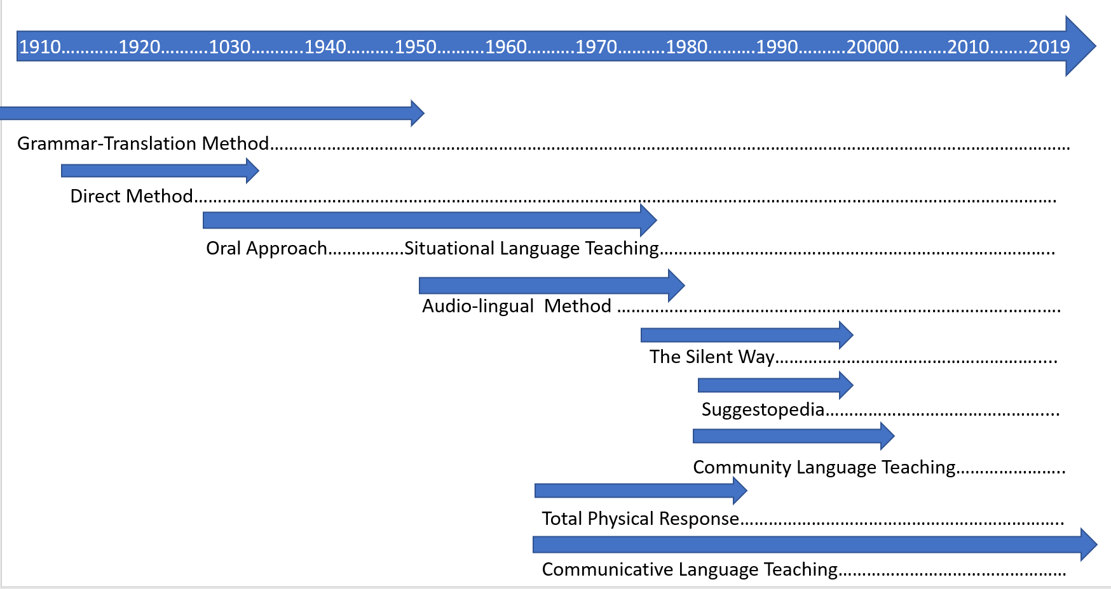
The International Context: Shifting Paradigms
Notes:
As we all know language teaching has undergone huge changes in the last century, moving from the grammar translation method onto a teacher-centred structural approach which stressed the importance of accuracy and memorisation (Kissau, 2013: 580) and was based on a behaviourist view of learning to a communicative approach which emphasises communicative competence and student interaction in the L2 via participation in relevant and cooperative tasks and views learning as social.
Now, looking at this timeline you may say that the paradigm shift to CLT really h more than a generation ago? There is significant evidence that the paradigm shift doesn’t necessarily happen and I really wanted to find out if that was the case in the context of Ireland.
So why did I want to investigate this? As I mentioned earlier I work in Ireland as a teacher of French, Spanish and German. In 2015 I began to my Masters in Applied Linguistics with the University of Birmingham and this research was to become the topic of my research project.
Ireland is currently undergoing the most significant educational reform of lower secondary education, which puts “the student at the centre of the learning experience and allows a wider range of skills to be properly assessed”. For those of you not familiar with the Irish education system, it is a system which places huge value in externally set and assessed examinations.
In 2016 I started to work for a teacher support service designing and facilitating in-service teacher training events to implement a national curricular reform. I was struck by the level of resistance to a curriculum which was grounded in communicative principles as well as bringing language teaching in Ireland in line with the common European framework of reference for the first time.

Slide 7
Research Questions:
Are teachers’ beliefs based on any outdated beliefs which contradict our current understanding of Second Language Acquisition (SLA)?
Do Irish language teachers’ beliefs support a communicative approach to language learning?
Are teachers’ beliefs about language learning linked to their attitude towards curricular reform?
Notes:
I particularly wanted to know the following: If they are then we as teacher trainers have to challenge those outdated beliefs? Some of my beliefs had turned out to be quite outdated when I began to question them during my masters.
I also wanted to know if teachers were actually using a communicative approach. When meeting teachers from all across Ireland I was struck by the range of approaches and I had only recently questioned my own approach during my studies.
First and foremost I wanted to find out why some teachers were so negative about this reform. I wanted to know if it was linked to any of the above or if it was linked to the school in which they teach or maybe it was linked to other factors.
So I went about researching what we even mean by teachers’ beliefs?

Slide 8
What are Beliefs and why investigate them ?
“It is important to change teachers’ beliefs and core values in education in times of educational reform in order to avoid superficial change were teachers simply change strategies while unreflectively rejecting all deeper changes.” ( Fullan, 1991)
“Beliefs are an individual’s representation of reality or what an individual holds to be true, whether or not evidence supports that representation.” (Pajares 1992: 316)
Notes:
When reviewing current literature into teachers’ beliefs some things struck me in particular. Pajares sums up one of them very well…
We often think we know something but the line between knowledge and belief is murky and unless we question our beliefs from time to time we come to accept what we believe as knowledge.
In the context of curricular reform this reflection on our beliefs is particularly important because we are trying to challenge the status quo and unless we question the rationale for reform and understand why we are changing the way we teach the reform will not embed and paradigms will not shift.
Let me give you a couple of examples…
Teachers are aware of their beliefs to varying degrees in a given moment
Beliefs will be evoked by a particular context or task
Contradictory beliefs can coexist simultaneously
(Fives and Buehl, 2016)

Slide 9
Knowledge or Belief?
“Most of the mistakes that second language learners make are due to interference from their first language.”
“Languages are mainly learned through imitation.”
Notes:
Here are two examples. Take a moment to read these statements and reflect…do you believe this or do you know this?
Did this make you wonder?
There is considerable research that suggests that what we believe has an impact on what we do so what we believe affects how we teach. I did not want to just watch teachers teach and draw my own conclusions. Instead I wanted to ask teachers what they believed and also find out how they teach. The complex nature of teacher beliefs meant that my research had to capture teachers’ complex thoughts as well as their behaviour so this is how I went about it….
(Fives and Buehl, 2016)

Slide 10
Methodology of the Study
Mixed Model Research Design
Questionnaire, Focused Group Interviews and Individual Interviews
Questionnaire, Focused Group Interviews and Individual Interview
Quantitative Data Analysis using parametric and non-parametric statistics to examine relationships between the various themes
Qualitative Data Analysis using a priori themes expanded recursively throughout the analysis
Quantitative and qualitative data were integrated to report on overall findings
Notes:
Here are two examples. Take a moment to read these statements and reflect…do you believe this or do you know this?
Did this make you wonder?
There is considerable research that suggests that what we believe has an impact on what we do so what we believe affects how we teach. I did not want to just watch teachers teach and draw my own conclusions. Instead I wanted to ask teachers what they believed and also find out how they teach. The complex nature of teacher beliefs meant that my research had to capture teachers’ complex thoughts as well as their behaviour so this is how I went about it….
(Fives and Buehl, 2016)

Slide 11
Methodology and Participants
Phase 1
(Open to MFL teachers qualified to teach in Ireland)
Questionnaire
(social media, email )
Multiple Choice, Likert Scale and Open Questions
58 valid responses
Phase 2
(selected from
phase 1)
Focused Group Interview
Adobe Connect
4 participants
Individual Interviews
in person/ via phone
4 participants
Notes:
As you can see here my study was carried out in two phases: the questionnaire which was distributed via social media, emails etc and to which I obtained 58 valid responses which was followed by the second phase of focused group and individual intervies.
(Fives and Buehl, 2016)

Slide 12
Validity and Reliability
Internal Validity:
Geographical Triangulation, triangulation of methods,
member checking and
trial questionnaire
External Validity:
Thick description of patterns themes,
catalytic validity
Notes:
Thick description of the key patterns and emergent themes,
catalytic validity by providing clear implications for teacher training organisations

Slide 13
Limitations and Constraints of the Study
My current role as teacher trainer
Restricted time frame during the teacher holidays
Notes:
Thick description of the key patterns and emergent themes,
catalytic validity by providing clear implications for teacher training organisations

Slide 14
1. Are teachers’ beliefs based on any outdated beliefs which contradict our current understanding of Second Language Acquisition (SLA)?
Key Findings:
Teachers overall agreed with Outdated Beliefs in the Questionnaire
Some beliefs were contradictory when further explored in the interview stage
Taking part in the research was a catalyst for reflection and belief change
Notes:
Here are some examples of outdated beliefs that teachers agreed with strongly.
These were further explored in the interview stage where it became apparent that
Languages are learned mainly through imitation
It is essential for learners to be able to pronounce all the individual sounds of the second language
Most mistakes are due to interference from their first language
This study confirmed my initial hypothesis that CPD events such as those which support the current curricular reform must challenge outdated beliefs, which are often held unconsciously, and perhaps innocently, having been passed down generation to generation.” (Burke, 2011). In line with current literature on conceptual change (Patrick and Pintrich, 2008) suggesting that a task or question can facilitate teachers’ reflection and help them question long-held beliefs, thus providing a catalyst for belief change.

Slide 15
2. Do Irish language teachers’ beliefs support a communicative approach to language learning?
Key Findings:
Overall, teachers were more aligned with structural principles
Teachers follow both structural and communicative principles
Strong correlations between beliefs and approach
Strong correlation between approach and context ( examinations)
Notes:
Here are some examples of outdated beliefs that teachers agreed with strongly.
These were further explored in the interview stage where it became apparent that
Languages are learned mainly through imitation
It is essential for learners to be able to pronounce all the individual sounds of the second language
Most mistakes are due to interference from their first language
This study confirmed my initial hypothesis that CPD events such as those which support the current curricular reform must challenge outdated beliefs, which are often held unconsciously, and perhaps innocently, having been passed down generation to generation.” (Burke, 2011). In line with current literature on conceptual change (Patrick and Pintrich, 2008) suggesting that a task or question can facilitate teachers’ reflection and help them question long-held beliefs, thus providing a catalyst for belief change.

Slide 16
3. Are teachers’ beliefs about language learning linked to their attitude towards curricular reform?
Key Findings:
Teachers’ Attitudes towards reform is linked to
their overall approach
whether they feel supported
their teaching experience abroad
Their conceptual clarity of
Communicative Intent
Learner Autonomy
Notes:
Here are some examples of outdated beliefs that teachers agreed with strongly.
These were further explored in the interview stage where it became apparent that
Languages are learned mainly through imitation
It is essential for learners to be able to pronounce all the individual sounds of the second language
Most mistakes are due to interference from their first language
This study confirmed my initial hypothesis that CPD events such as those which support the current curricular reform must challenge outdated beliefs, which are often held unconsciously, and perhaps innocently, having been passed down generation to generation.” (Burke, 2011). In line with current literature on conceptual change (Patrick and Pintrich, 2008) suggesting that a task or question can facilitate teachers’ reflection and help them question long-held beliefs, thus providing a catalyst for belief change.

Slide 17
Implications
Assessment practices are key in facilitating a paradigm shift towards Communicative Language Teaching
In-service CPD programmes need to help teachers question their own fundamental assumptions, values, and beliefs to facilitate conceptual change
Teaching Opportunities abroad are an effective form of professional development and need to be further supported
Notes:
Here are some examples of outdated beliefs that teachers agreed with strongly.
These were further explored in the interview stage where it became apparent that
Languages are learned mainly through imitation
It is essential for learners to be able to pronounce all the individual sounds of the second language
Most mistakes are due to interference from their first language
This study confirmed my initial hypothesis that CPD events such as those which support the current curricular reform must challenge outdated beliefs, which are often held unconsciously, and perhaps innocently, having been passed down generation to generation.” (Burke, 2011). In line with current literature on conceptual change (Patrick and Pintrich, 2008) suggesting that a task or question can facilitate teachers’ reflection and help them question long-held beliefs, thus providing a catalyst for belief change.

Slide 18
#eaquals19madrid
Notes:
Good Morning and thank you for joining me here today. My name is Elisabeth Butler and I am joining you from my adopted home country of Ireland where I have lived for more than twenty years. Anyone here from Ireland today? …I am originally from Austria ..anyone from Austria? …Very good. This is my first Eaquals conference and I am delighted to be here today. I am presenting to you the findings from my recent study of language teachers’ beliefs about language learning and their attitude towards curricular reform.

