Slide 1
INTO THE WILD (OF EFL)
Oliver Wood & Antonella Rossi

Slide 2
Into the Wild (of EFL)

Slide 3
From ELL to ELT

Slide 4
Learner Autonomy

Slide 5
Learner Preferences

Slide 6
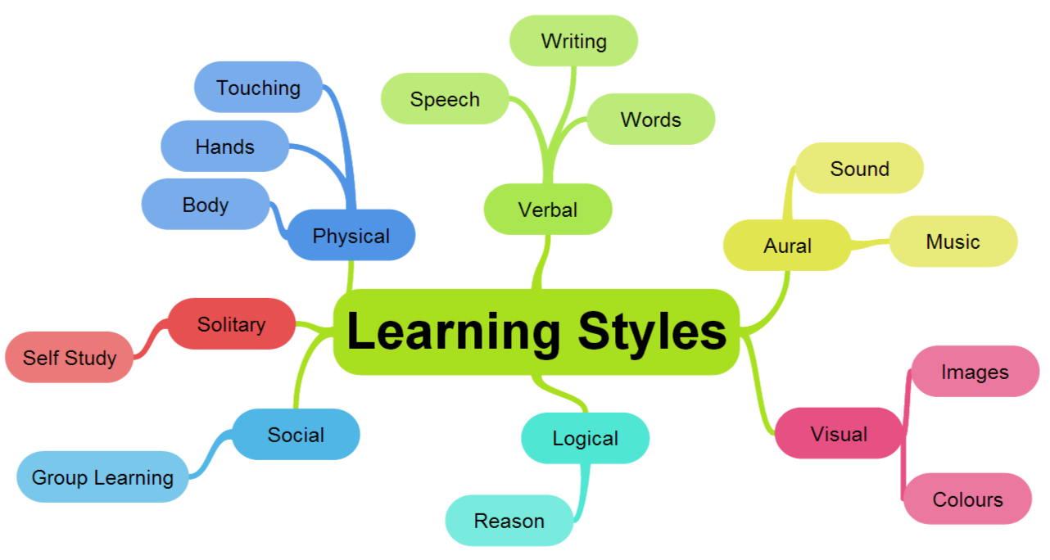

Slide 7
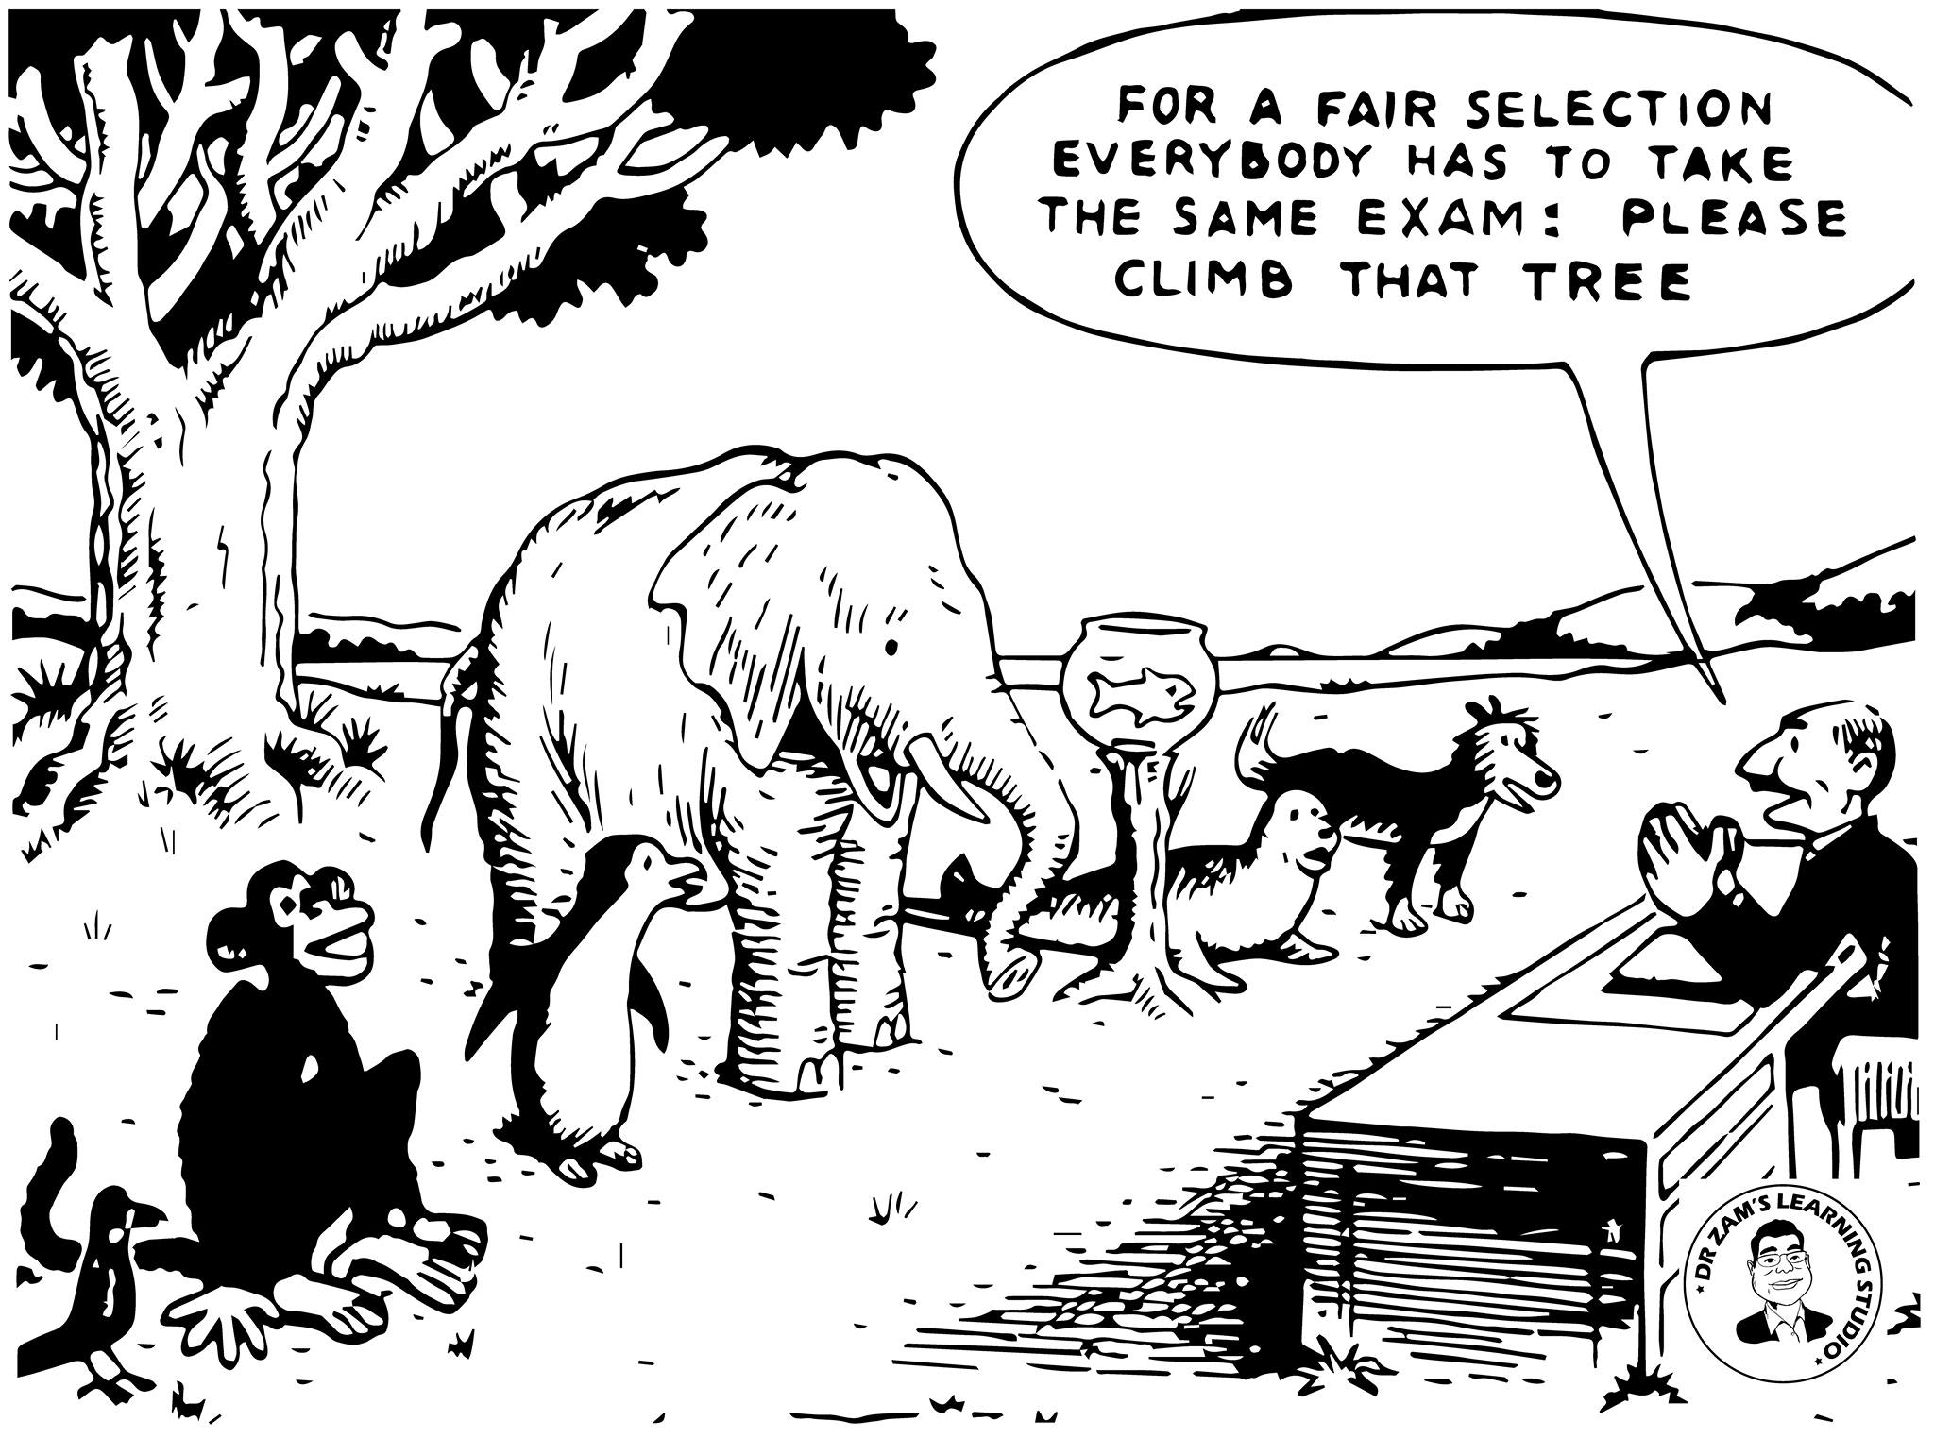

Slide 8
Repetition

Slide 9
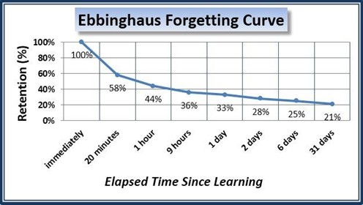

Slide 10
Learner-Teacher Equality

Slide 11
Affective filter

Slide 12
L1 v L2

Slide 13
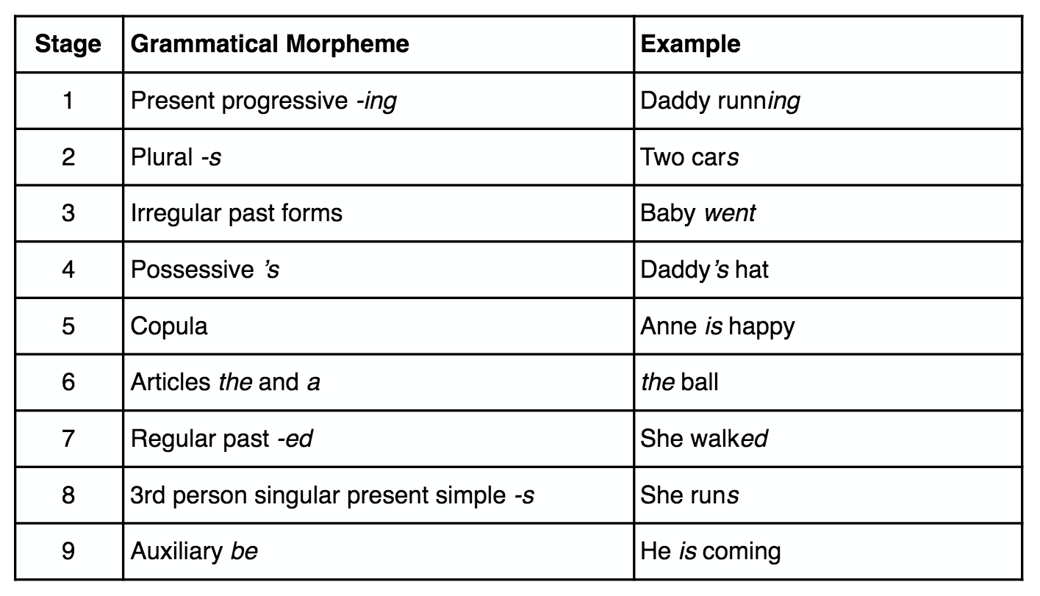

Slide 14
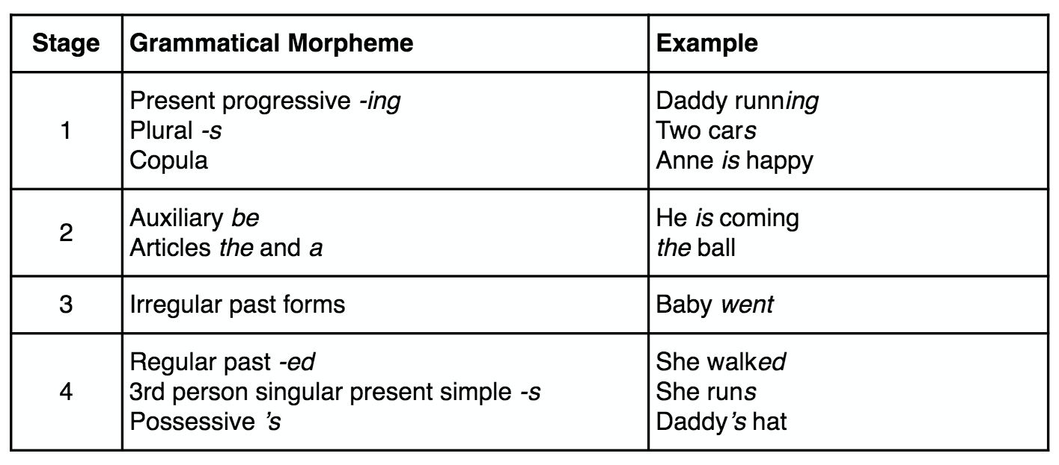

Slide 15
NEST v NNEST

Slide 16
NEST v NNEST
75%
97%
81%

Slide 17
Into the Wild (of ELF)

Slide 19
Thank you for listening!
Special thanks to the Eaquals Grant Scheme

