Slide 1
Google Analytics Workshop for Language Schools
Presented by
Philippe Taza
CEO, Higher Education Marketing
#eaquals19krakow

Slide 2
Today’s Presentation
Navigating the Google Analytics Interface
Construct an effective measurement plan
Setting up an Account
Recommended configuration/settings
Goals and Conversion Tracking
Basic Report Sections and Features
Utilize key digital measurement concepts and terminology

Slide 4
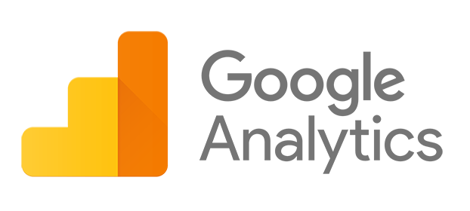
What is
Google Analytics?
Data
Collection
Configuration
Data
Processing
Reporting

Slide 5
Why use
Google Analytics?
Google Analytics is the most-used web analytics tool in the world
Over 10 million websites use GA
GA offers invaluable insight into your recruitment campaigns & how to improve them

Slide 6
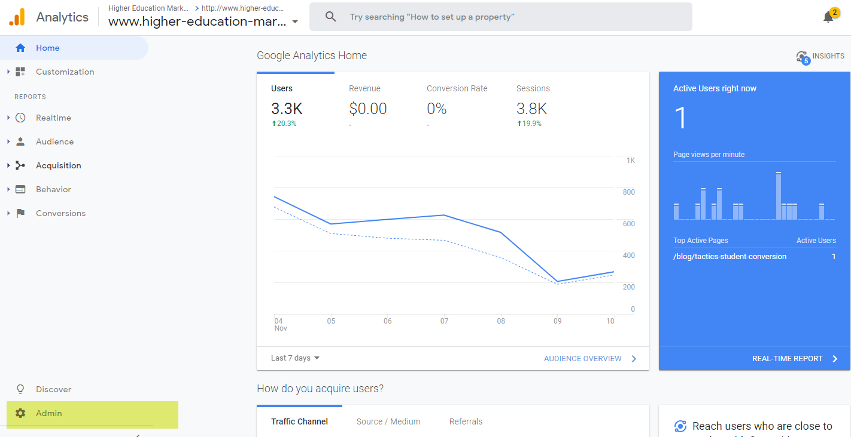
The Google Analytics Interface
Select the Admin tab to access the Google Analytics control panel

Slide 7
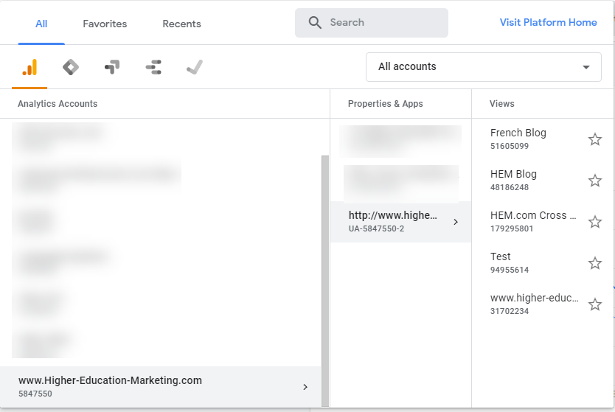
Managing Google Analytics Accounts
With your email you have access to multiple GA accounts
Each account can have many properties and views

Slide 8
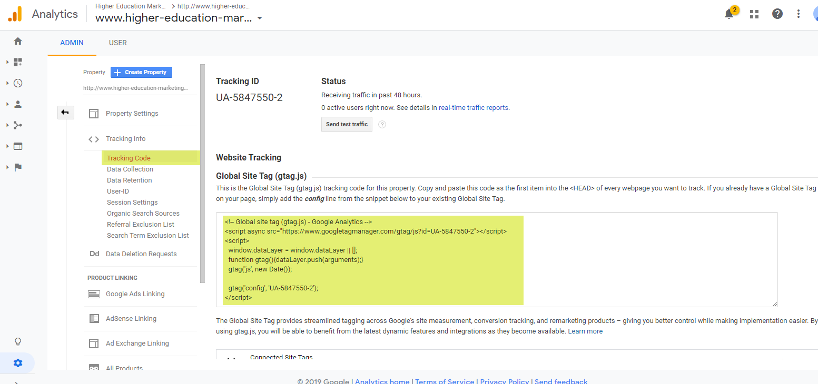
Setting up an account
It’s really easy to get up and running with Google Analytics, just insert the code into the pages you want to track.

Slide 9
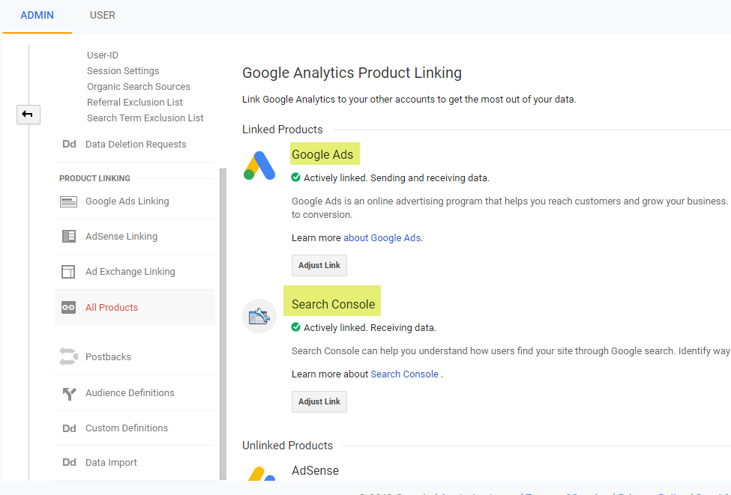
Linking Google Ads & Search Console
If you are marketing with Google Ads, link your accounts for better tracking
Search Console provides deep insights into your website and should be linked

Slide 10
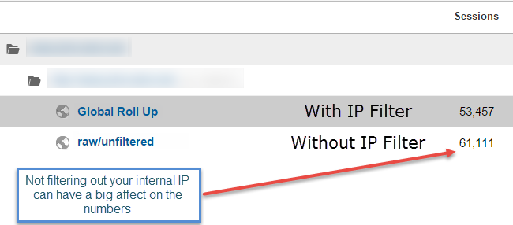
Remove internal traffic – set up an IP Filter

Slide 11
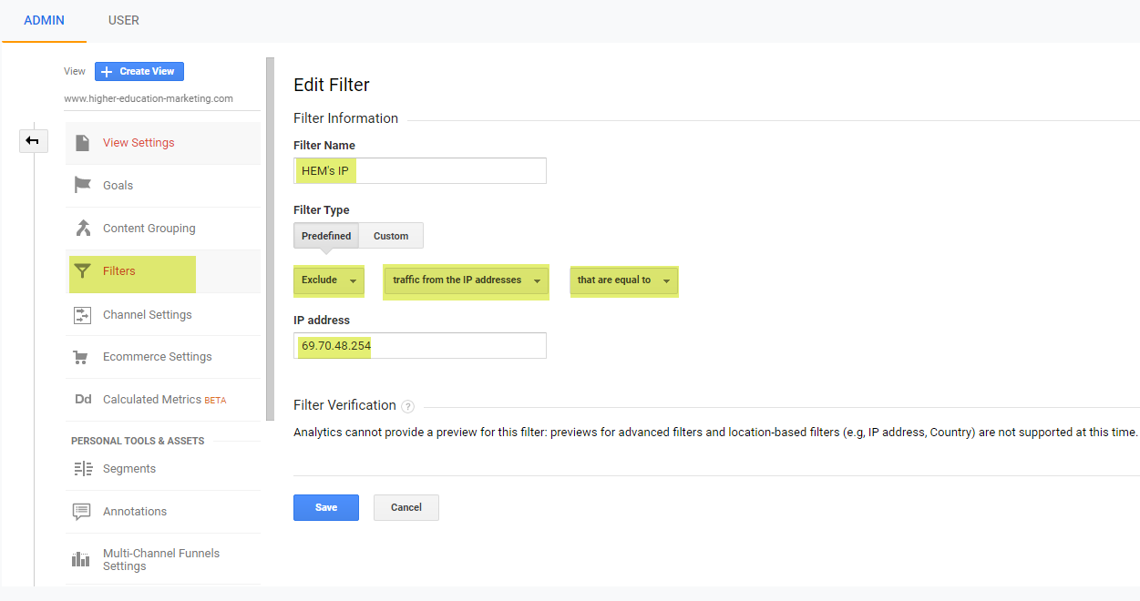
Remove internal traffic: Set up an IP Filter

Slide 12
Sharing Google Analytics access
Google Analytics provides many levels of permissions for sharing access

Slide 13
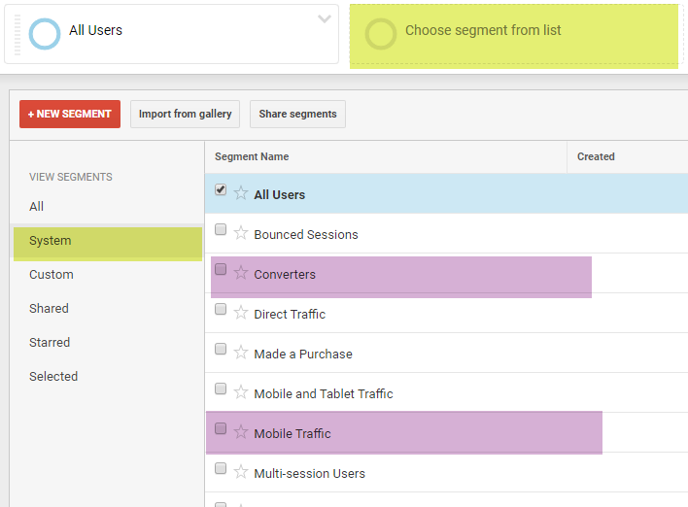
Choose from many Default Segments
Under the system tab, you will find 22 segments to choose from. The purple ones are some of my favorites.
New custom segments can also be created for advanced users!

Slide 14
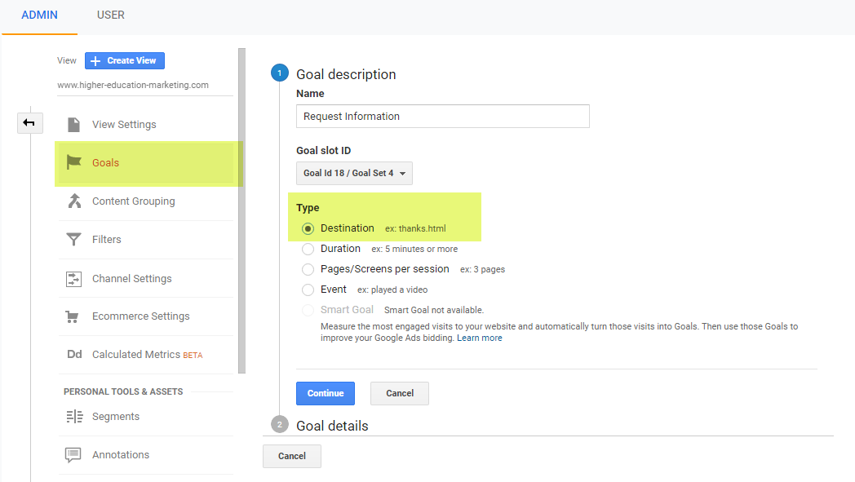
Setting up Website Goals
You can track many types of goals in Analytics

Slide 15
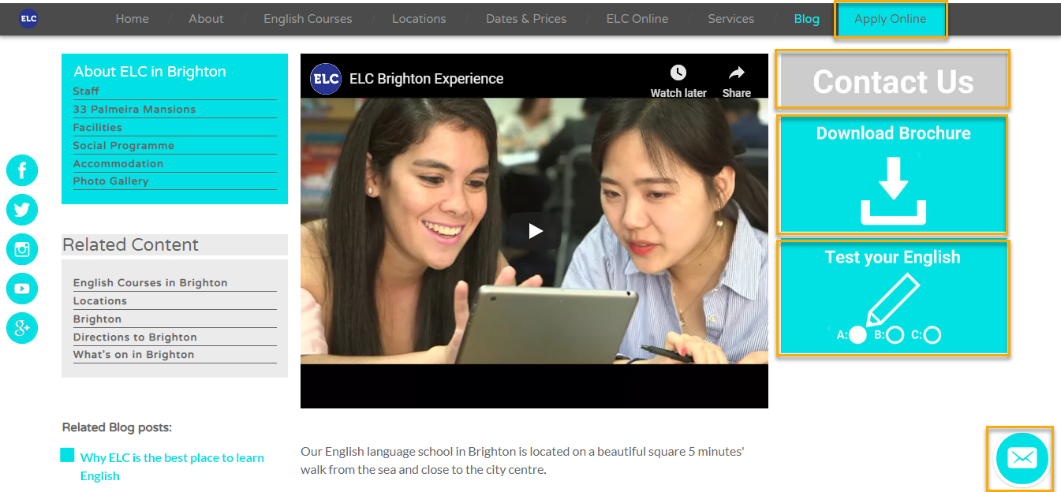
Finding Goals on Your Website
This homepage has 5 measurable goals:
1
2
3
4
5

Slide 16
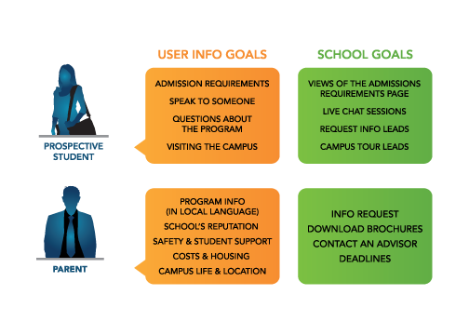
Goals vary based on personas
Its important to map out the goals that the various users may have.
Google Analytics makes it possible to track and measure many types of goals.

Slide 17
Macro vs. Micro Conversions
A macro conversion is anything that fulfils one of your school’s primary objectives.
Micro conversions are actions on a smaller scale that bring them closer to that goal.
Macro Conversions | Micro Conversions
Online booking Request info form submission Free quote completion | Brochure download Page view Video view

Slide 18
Exercise 1
Define Google Analytics Goals

Slide 19
Setting up a Request Info Goal
The request info goal is very common on EDU websites. To configure such a goal in Google Analytics, you will need 2 URLs:
The URL of the Form
The URL of the Thank You page users see once they fill out the form

Slide 20
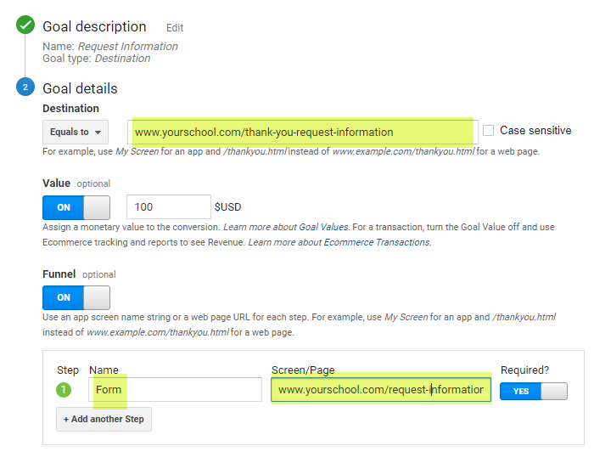
Setting up Website Goals
Thank you page URL
Don’t forget to assign a value to your goals. IN this case, the value can be calculated by dividing the average tuition amount by the average conversion rate of these request info leads becoming students
Request info from URL

Slide 21
Measurement plan framework
https://analytics.google.com/analytics/academy/course/7/unit/1/lesson/5
Run video until 3 minutes 35 seconds

Slide 22
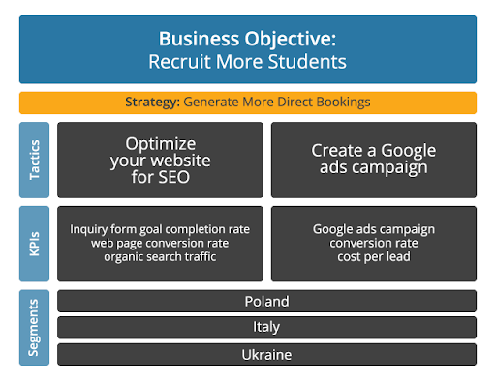
Language school GA measurement plan

Slide 23
Exercise 2
Create a GA Measurement Plan

Slide 24
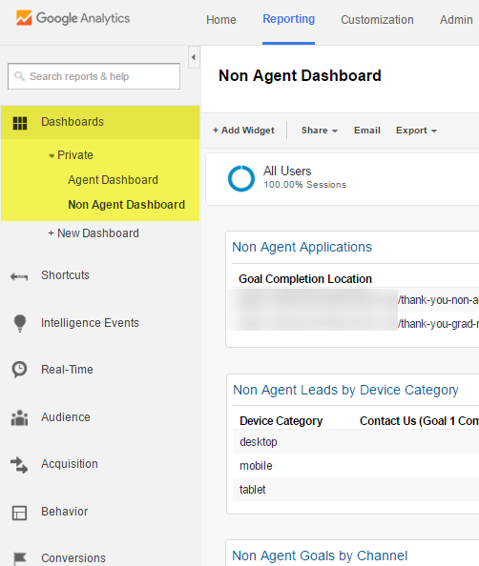
Use Dashboards to report on your plan

Slide 25
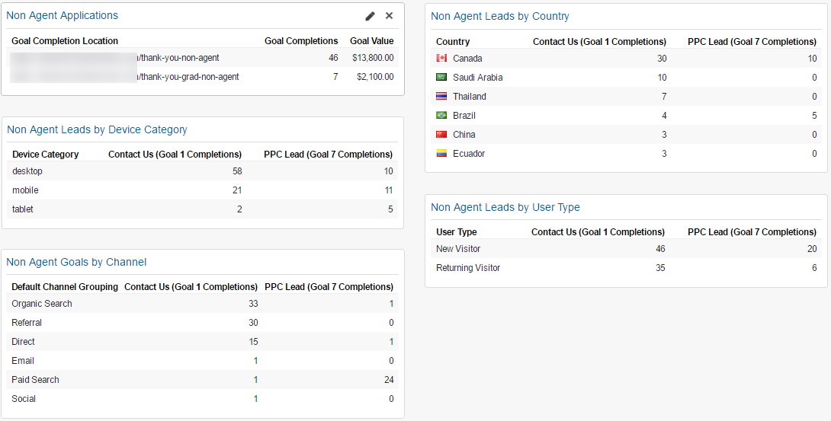
Non Agent Dashboard

Slide 26
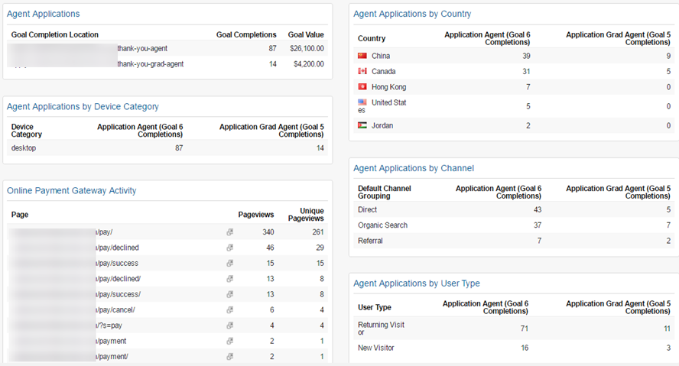
Agent Dashboard

Slide 27
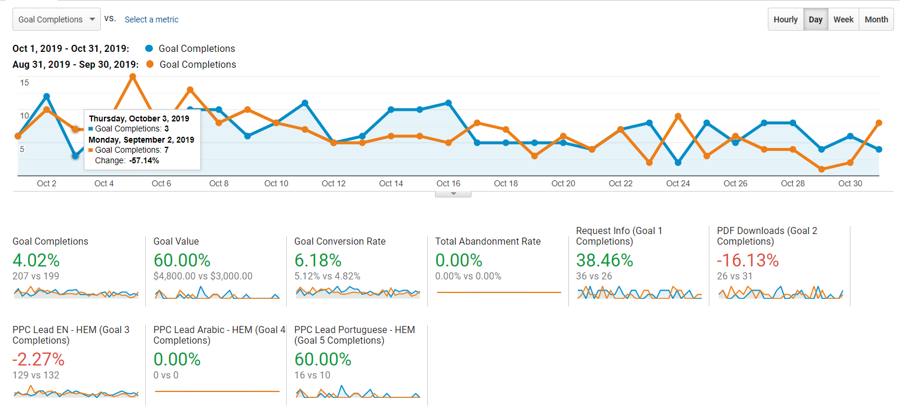
Month over Month Website Goals

Slide 28
The Google Analytics Reporting Interface
Choose your date range. By default last 30 day are selected. Month over month and year over year comparisons are available as well
You can access the main reports from this left navigation
Other cool features are available: exporting, email scheduling, etc.

Slide 29
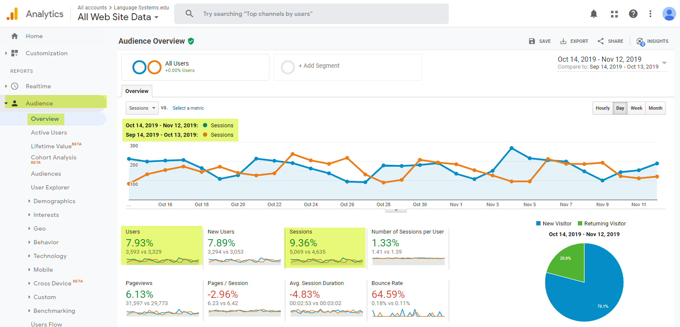
The Overview Report: where it all begins!
The Overview report under Audience, is the report you land on once you begin your Google Analytics journey.

Slide 30
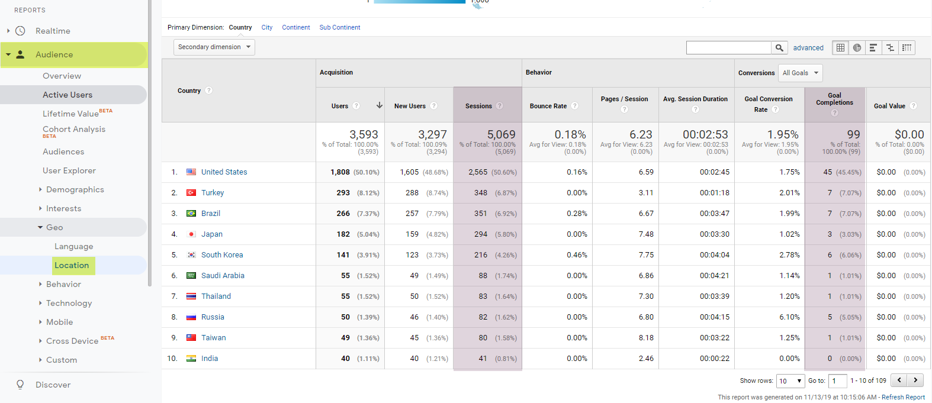
The Location Report
The Location report under Audience can tell you where your traffic is coming from: countries, states, cities, etc.

Slide 31
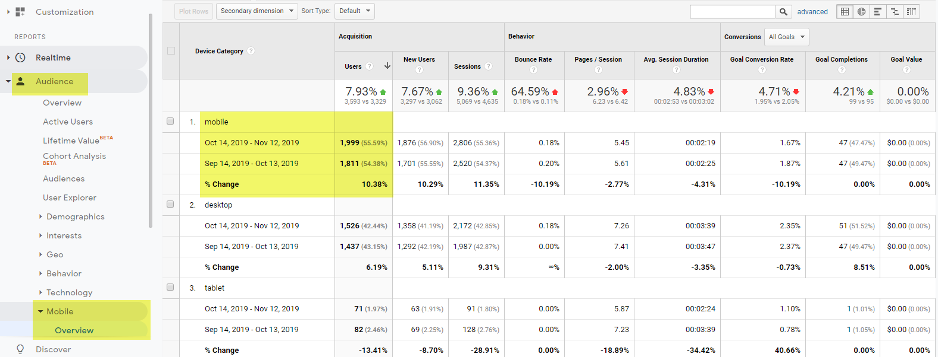
The Mobile Overview Report
The Mobile Overview report under Audience, can tell you more about the types of devices which are accessing your site.

Slide 32
What are the main Channels?
Organic: SEO Traffic from search engines
Email: links in email campaigns
Direct: users enter the URL directly in the browser
Referral: traffic from other sites yours is linked on
Social: Facebook, Twitter, LinkedIn, etc.
Paid Search: Google AdWords, Bing ads, etc.

Slide 33
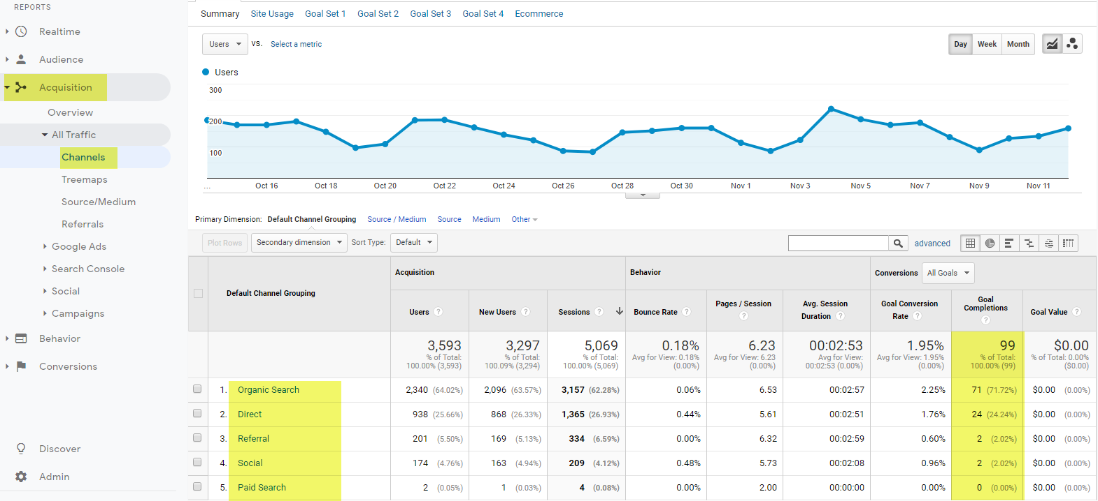
The Channel Report
The Channels report under Acquisition, gives you macro level insights into the various channels you are using to attract traffic to your website.

Slide 34
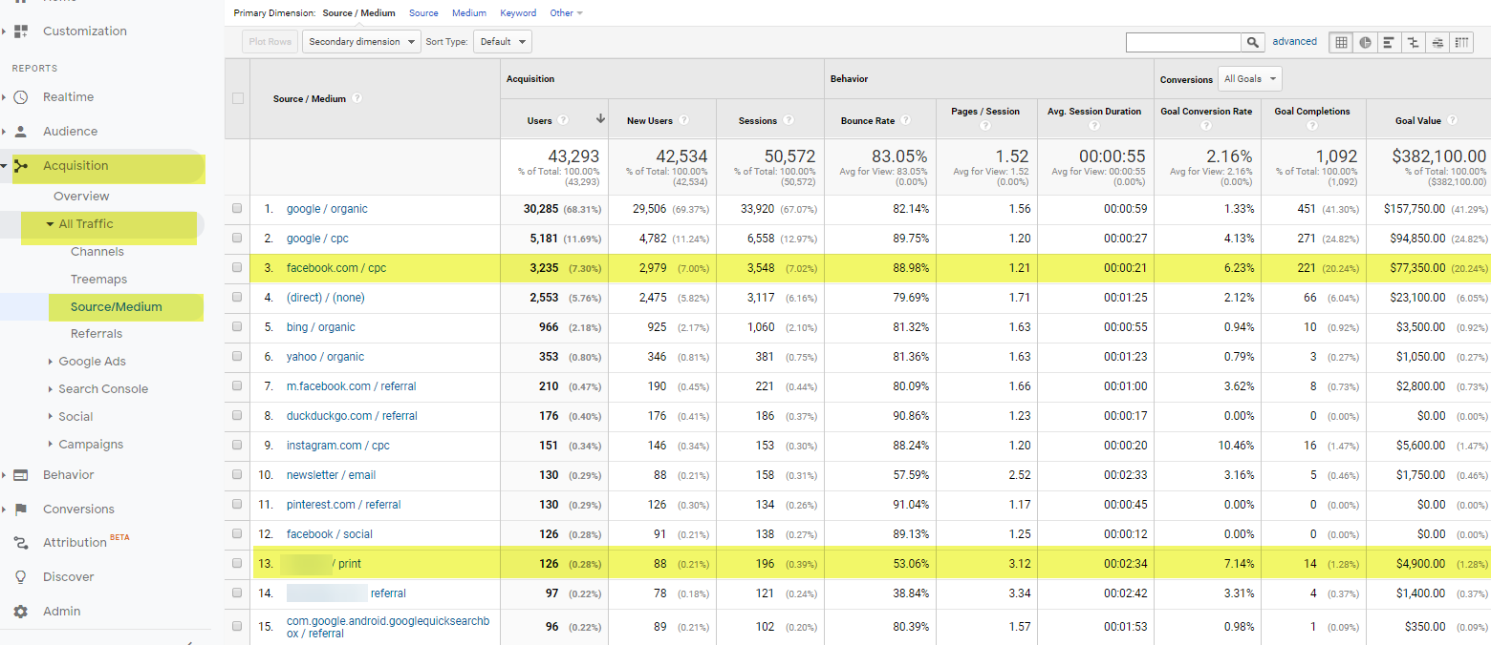
The Source/Medium Report
The Source/Medium report under Acquisition gives you micro level insights into the various sources of traffic your website is receiving. Notice how we are able to track offline Newspaper traffic and PPC initiatives on Facebook.

Slide 35
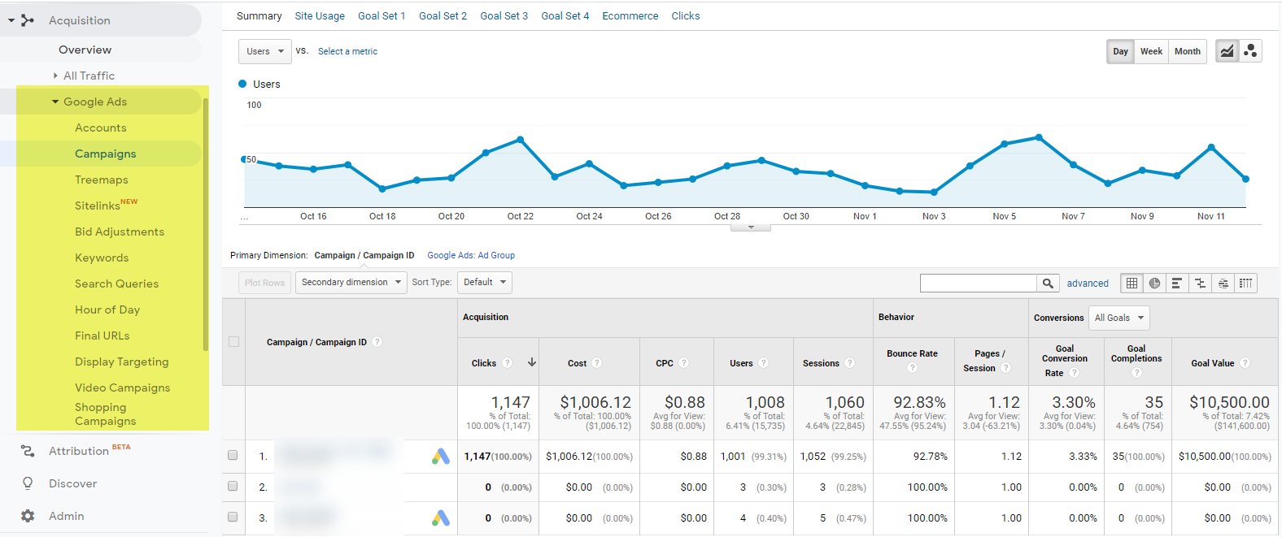
The Google Ads Campaign Report
Notice how Google Ads has a full section of reports, which are available under Acquisition. You will need to link Google Ads and Google Analytics to have these reports populated. For those of you using Google Ads, it would be important not to rely only on the data available in the Google Ads interface.

Slide 36
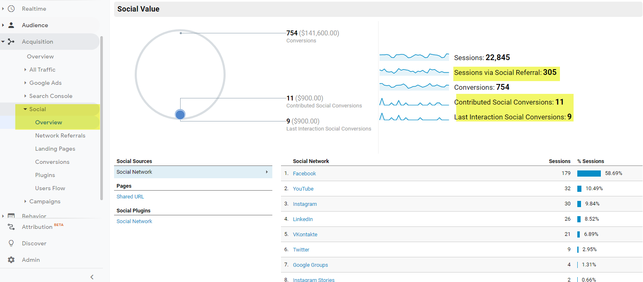
The Social Overview Report
The Social Overview report under Acquisition, gives you a snapshot of how your social channel is performing.

Slide 37
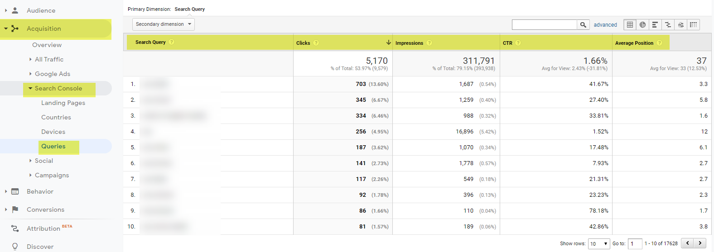
The Queries Report
The Queries report under Acquisition provides organic or SEO keyword level information. You can see what keywords your website is generating impressions and clicks from, and know what is your average position on Google. You will need to link Google Search Console and Google Analytics to have these reports populated.

Slide 38
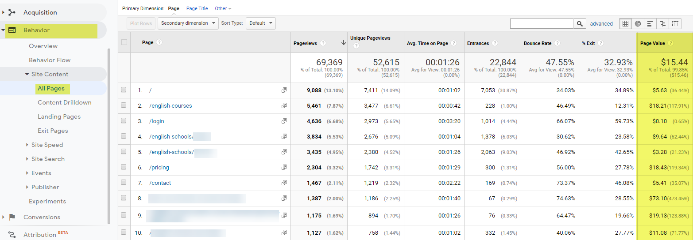
The All Pages Report
The All Pages report under Behavior gives you page by page insights, including how often it’s been viewed, the average time spent on that page, the bounce rate and the page value. The page value gives you an indication of the propensity of a user to convert on one of your goals after seeing that particular page.

Slide 39
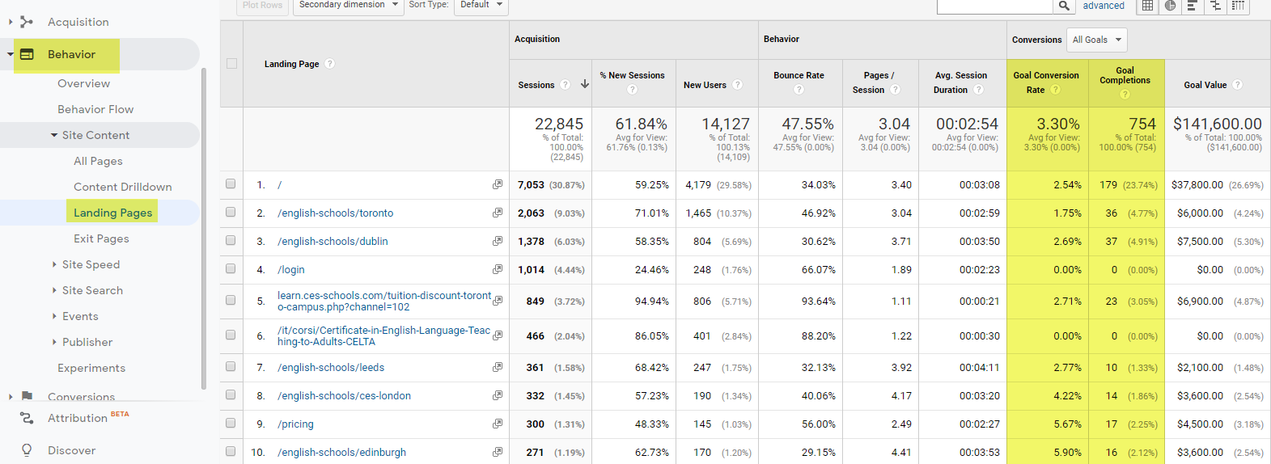
The Landing Pages Report
The Landing Pages report under Behavior provides information on the first pages users see or land on. The definition of landing page is the first page a user lands on.

Slide 40
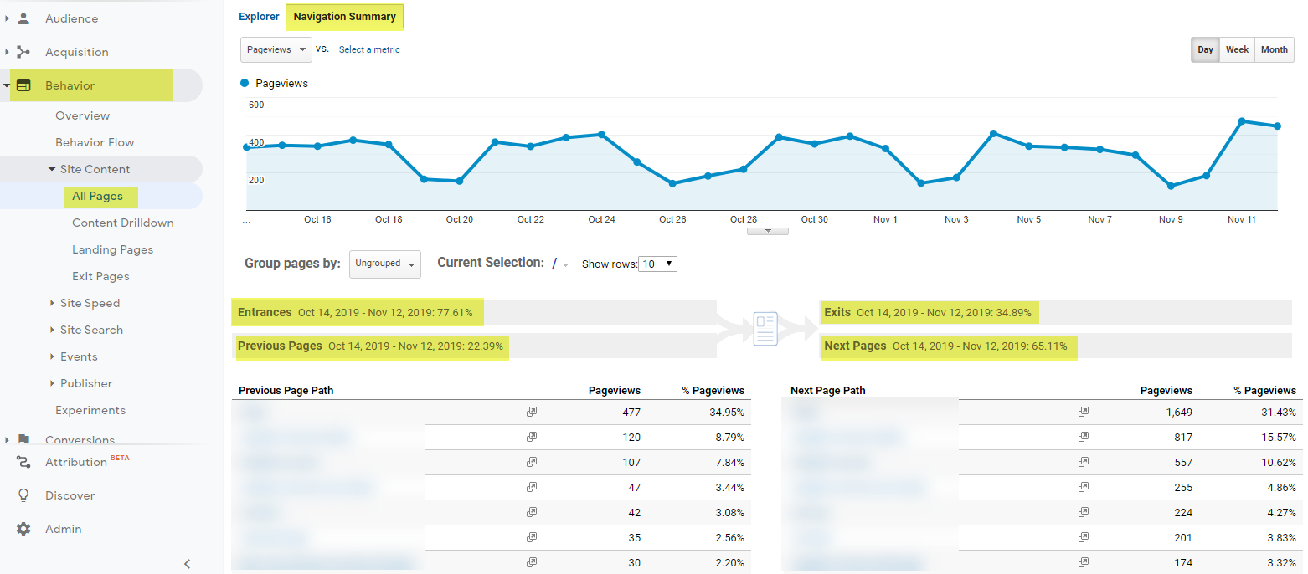
The All Pages Navigation Summary Report
The All Pages Navigation Summary report under Behavior provides detailed insights on which pages users visited before and after a particular page. You will also know what percentage of users enter and exit that page. This is one of my favorite reports ☺

Slide 41
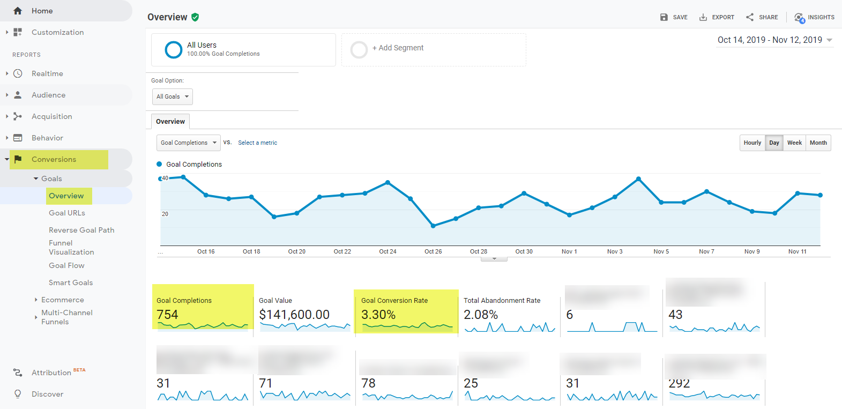
The Goals Overview Report
The Goals Overview report under Conversions, provides a summary view of the total number of conversions and conversion rate.

Slide 42
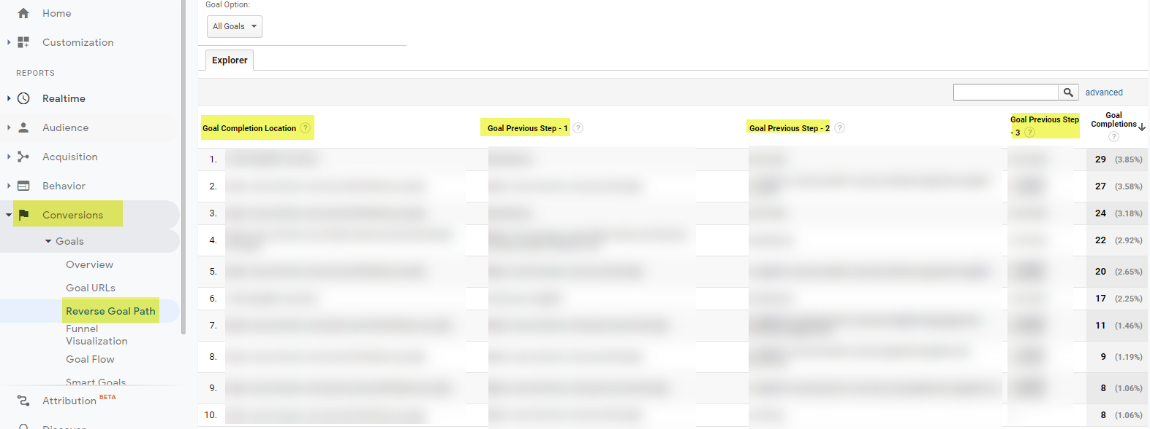
The Reverse Goal Path Report
The Reverse Goal Path report under Conversions tells you which pages were seen prior to converting.

Slide 43
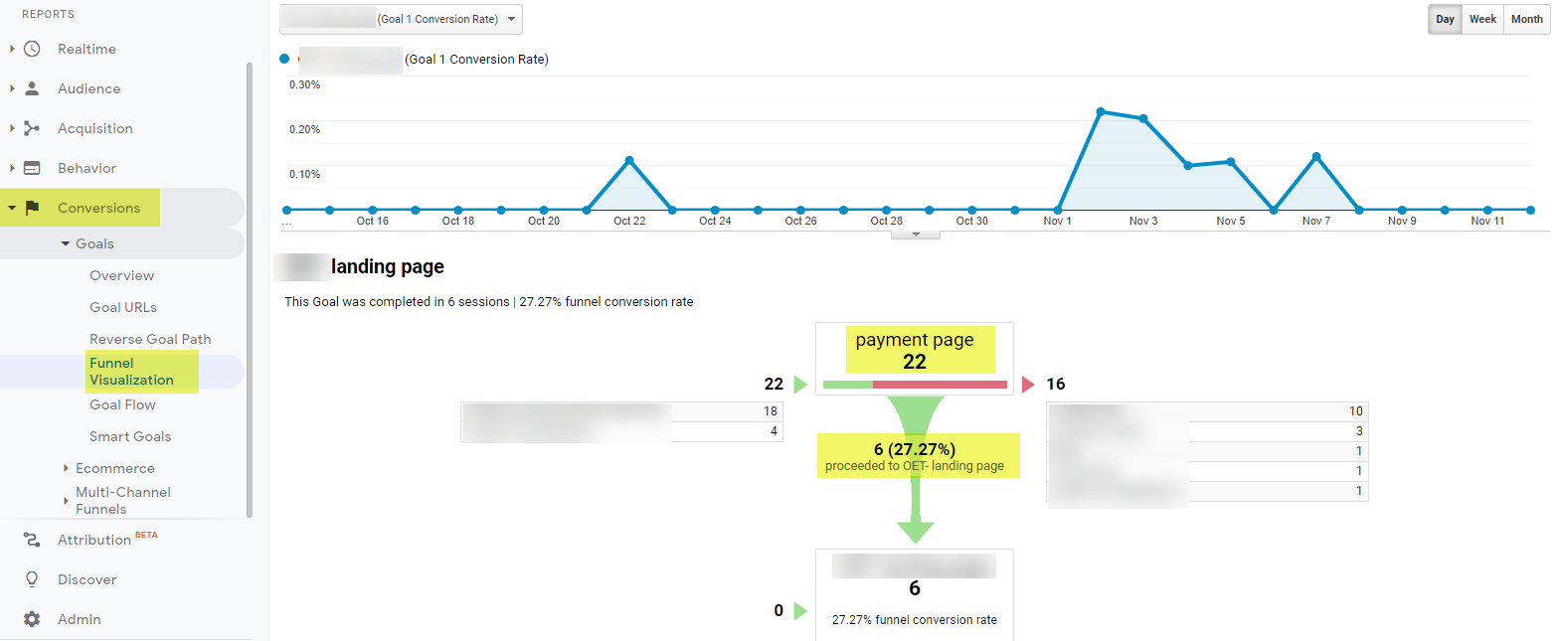
The Funnel
Visualisation Report
The Funnel Visualisation report under Conversions gives you insights on how effective your conversion page is. In this example, 27% of sessions decided to convert

Slide 44
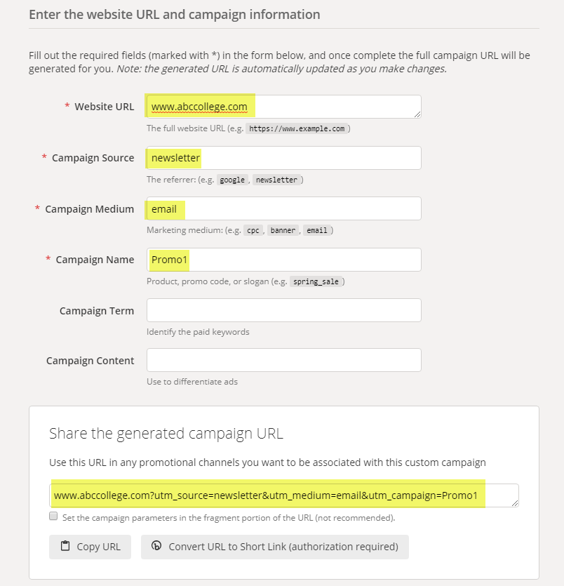
Google Analytics URL Builder
Use the URL builder to manually tag URLs you will use in specific campaigns.
Enter the URL, Source, Medium, and Campaign Name and the URL Builder will generate a unique URL for your campaigns

Slide 45
Exercise 3
Create Tracking Codes with Google’s URL Builder

Slide 46
Google Analytics Resources
Campaign URL Builder: https://ga-dev-tools.appspot.com/campaign-url-builder/
Google Analytics Academy: https://analytics.google.com/analytics/academy/Google Tag Manager:
https://tagmanager.google.com/
Google Analytics Blog
https://analytics.blogspot.com/

Slide 47
Generating Leads through SEO and Paid Advertising
Presented by
Philippe Taza
CEO, Higher Education Marketing
#eaquals19krakow

Slide 48
Today’s Presentation
Optimizing your website content for organic search
Monitoring your SEO efforts
Construct a keyword list
Creating a Google Ads campaign
Developing a Facebook Ads campaign
Monitoring your online ads

Slide 49
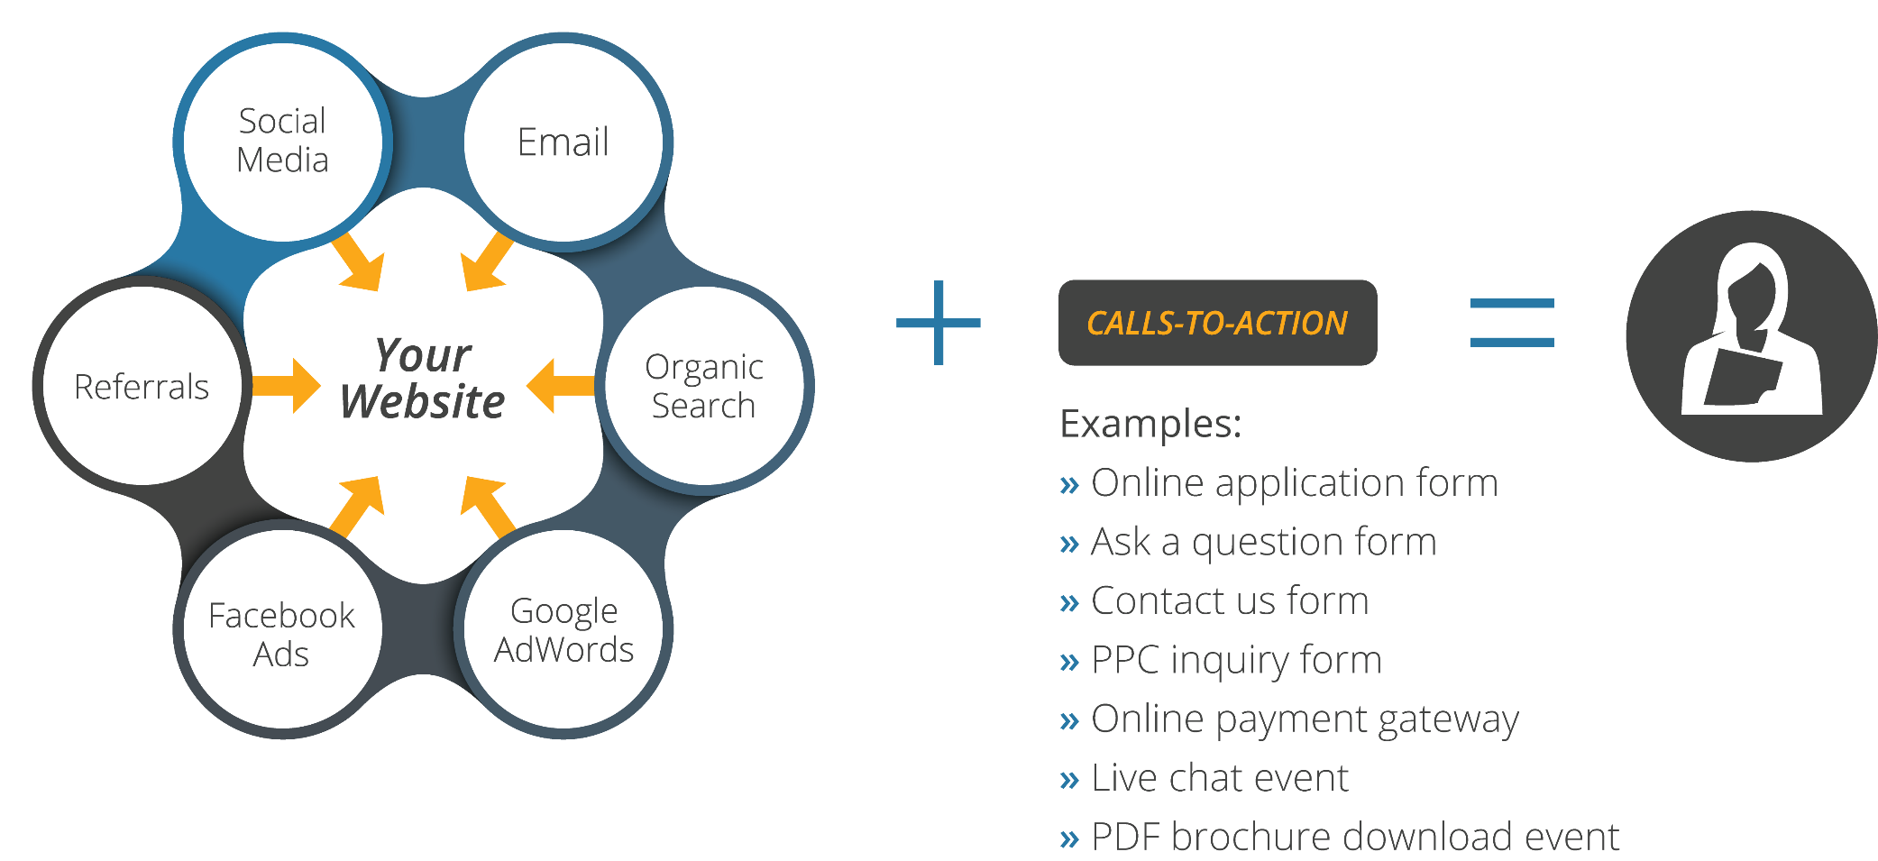
How Digital Marketing Attracts New Students

Slide 50
Organic vs.
Paid Search
Organic
Paid

Slide 51
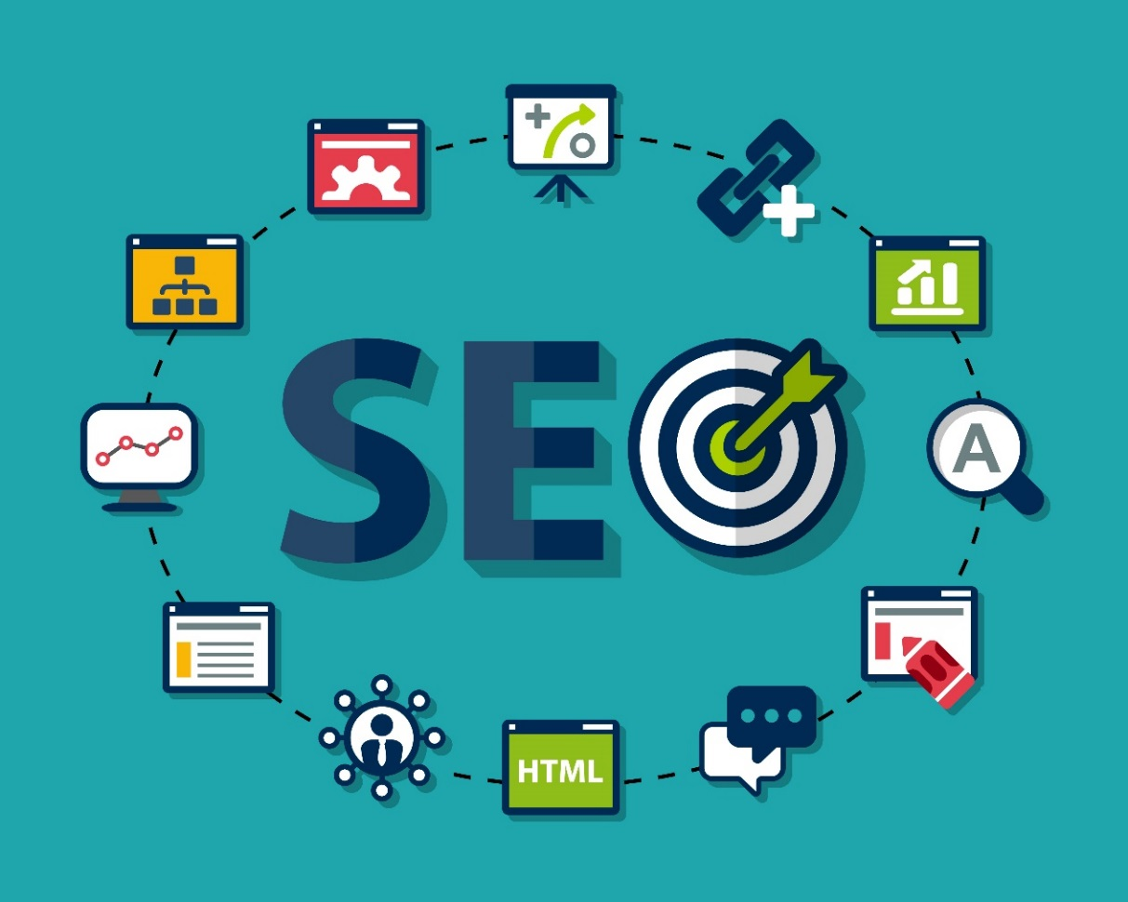
What is SEO?
The process of optimizing website content, design, & performance to generate visitor traffic from organic search engine results

Slide 52
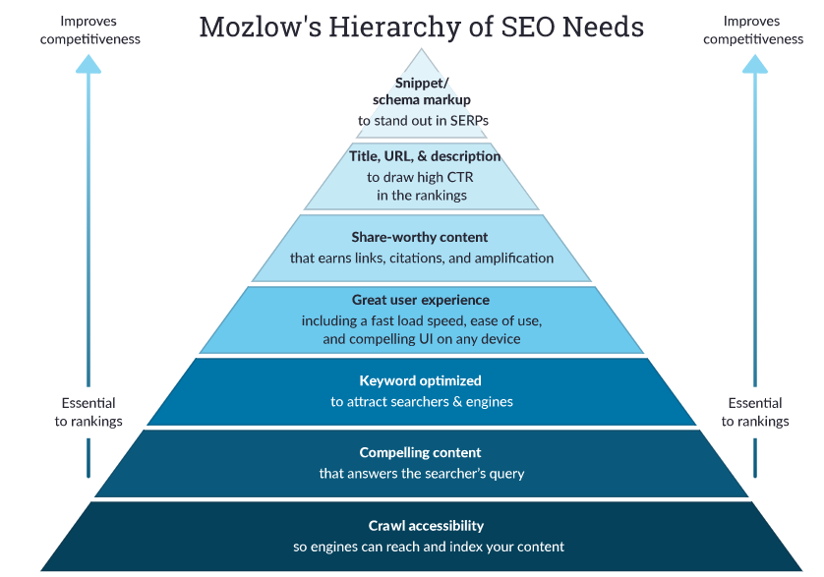
What does SEO
involve?
https://moz.com/beginners-guide-to-seo

Slide 53
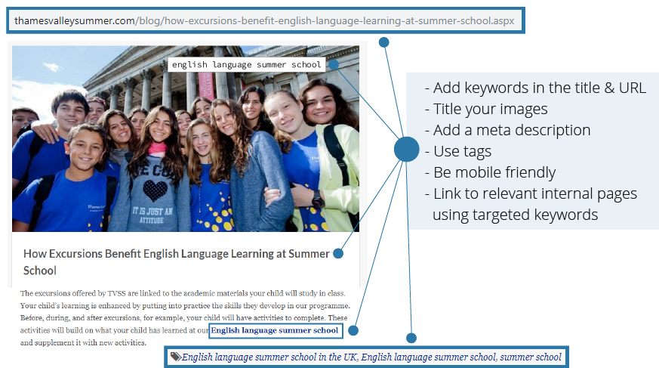
On Page SEO Example

Slide 54
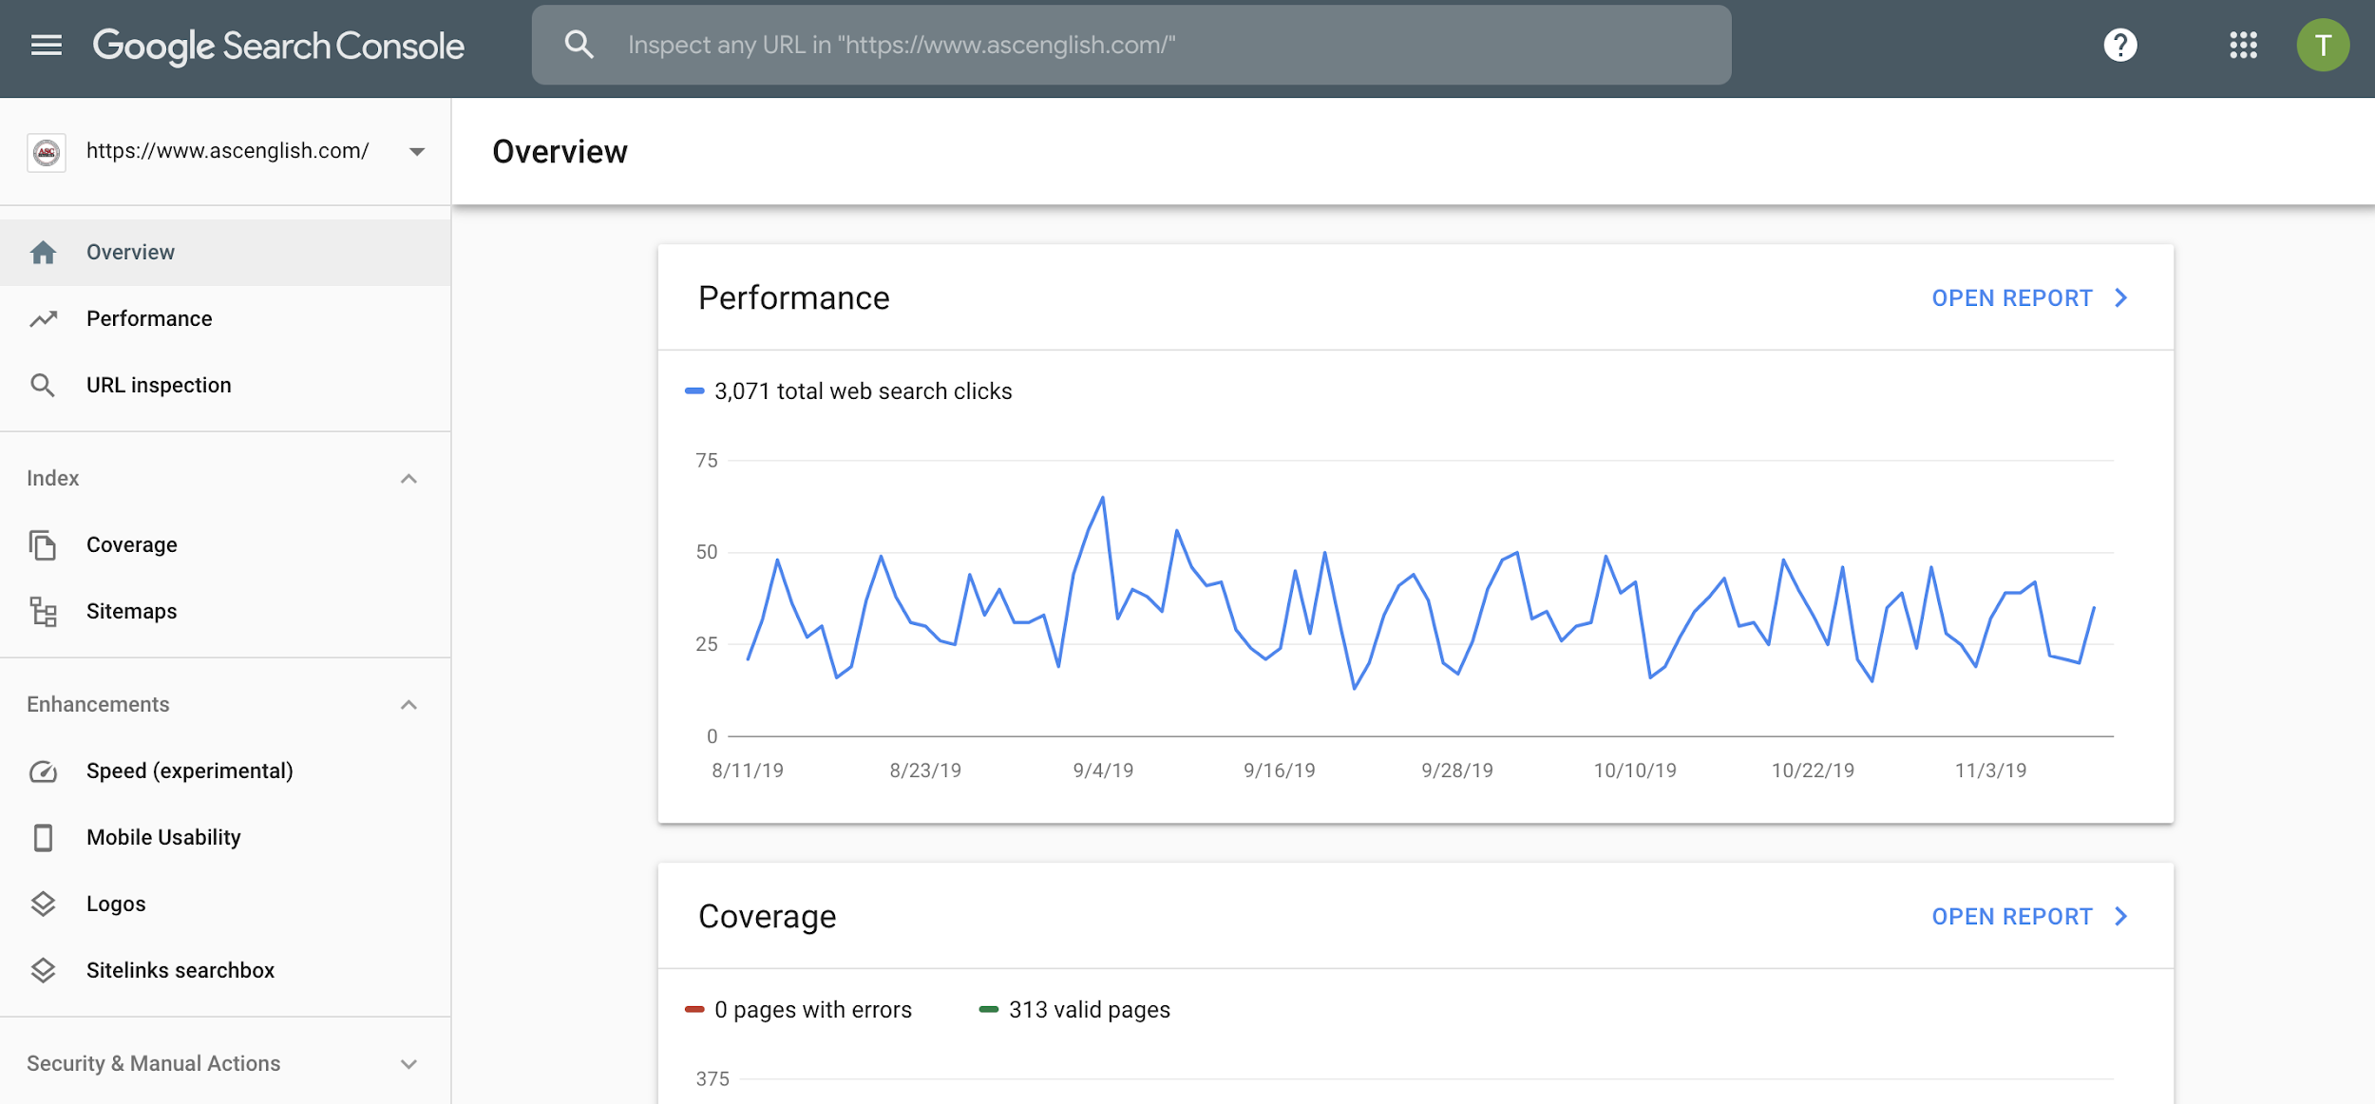
Google Search Console

Slide 55
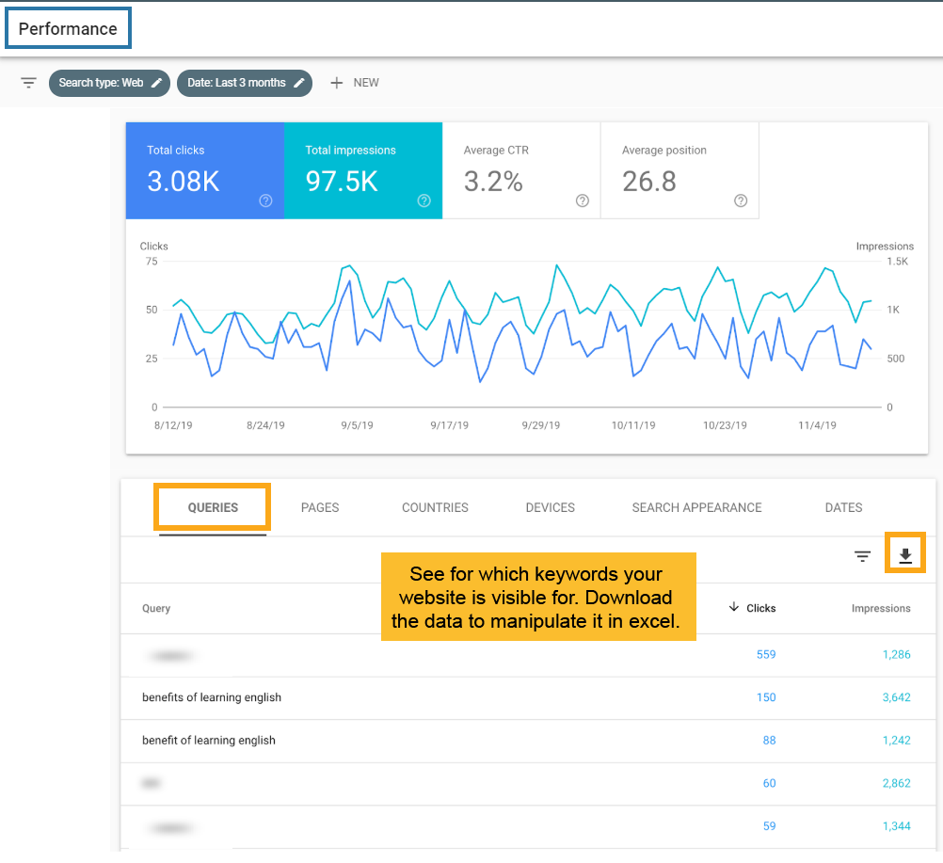
Google Search Console – Performance

Slide 56
Keywords from Google Search Console
Use this list of keywords to initiate your keyword research

Slide 57
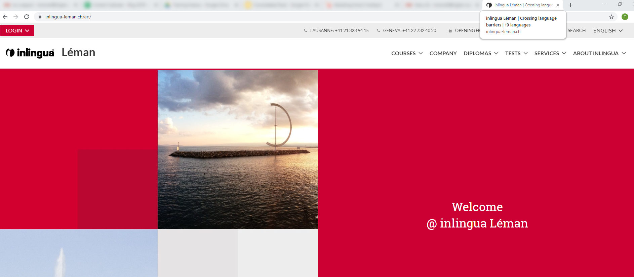
Look at the competition’s Titles

Slide 58
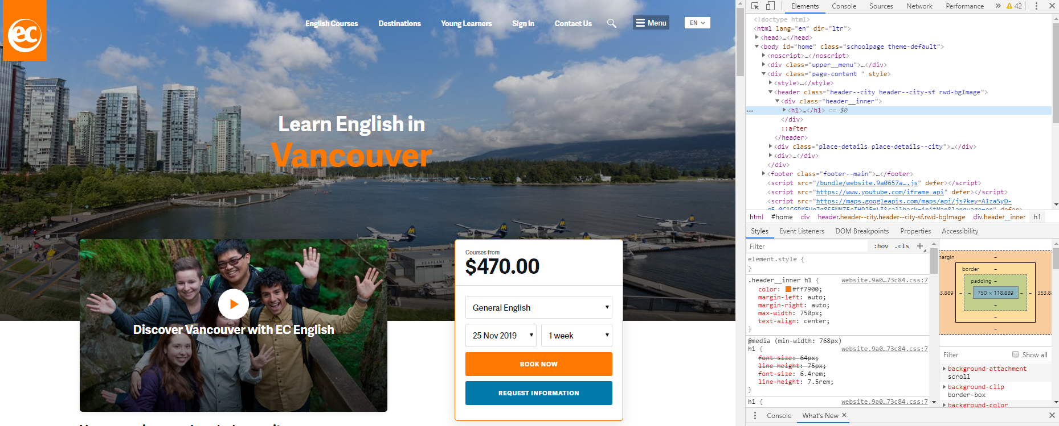
Look at the competition’s H1s

Slide 59
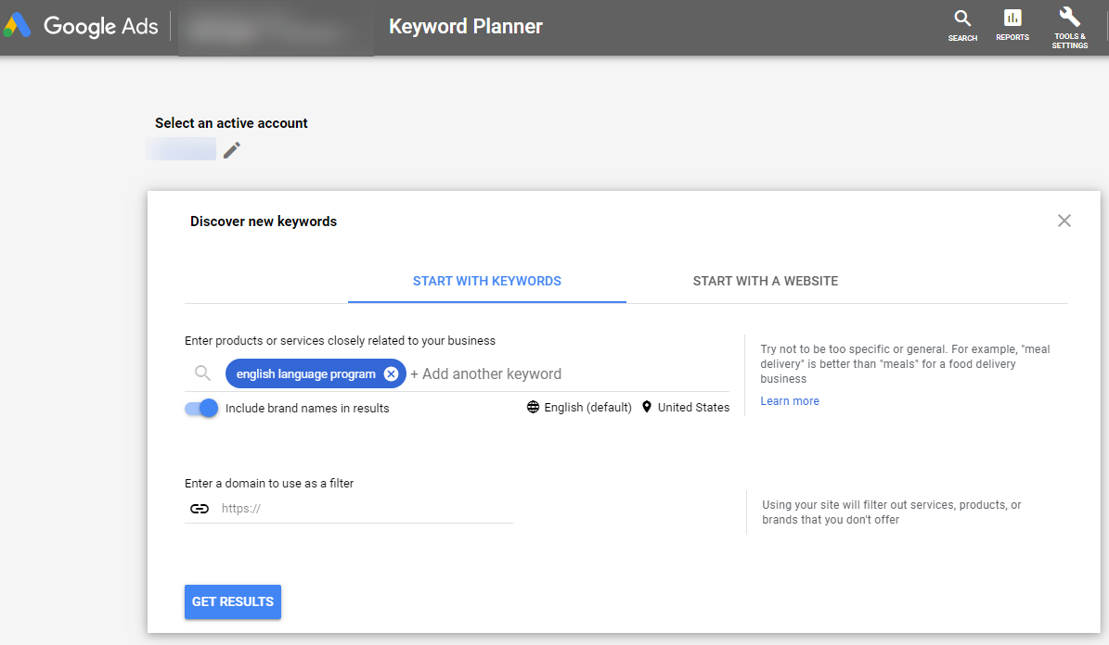
Research with Google Keyword Planner

Slide 60
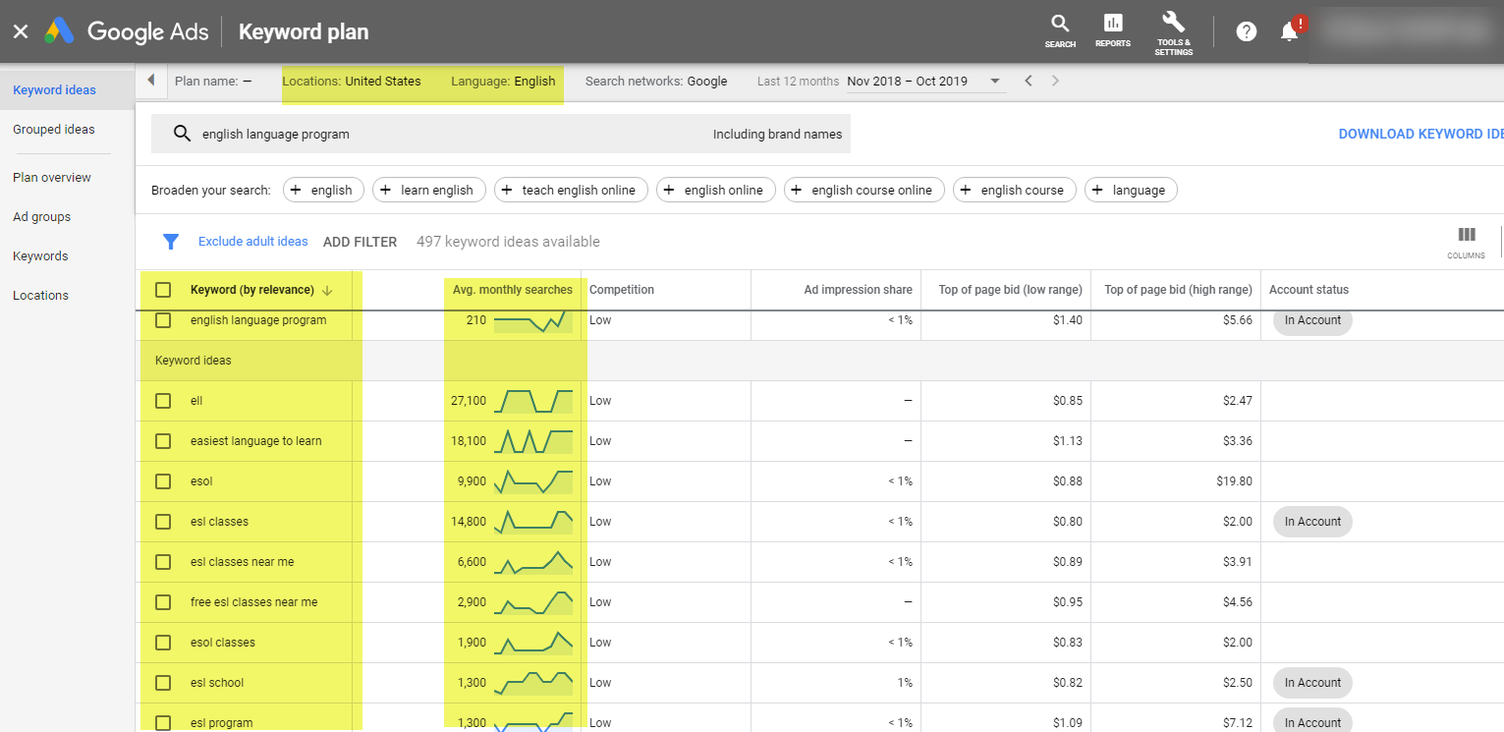
Research with Google Keyword Planner

Slide 61
Export your Keyword Research into Excel
UK
https://adwords.google.com/ko/KeywordPlanner

Slide 62
Exercise 4
Keyword Research for SEO

Slide 63
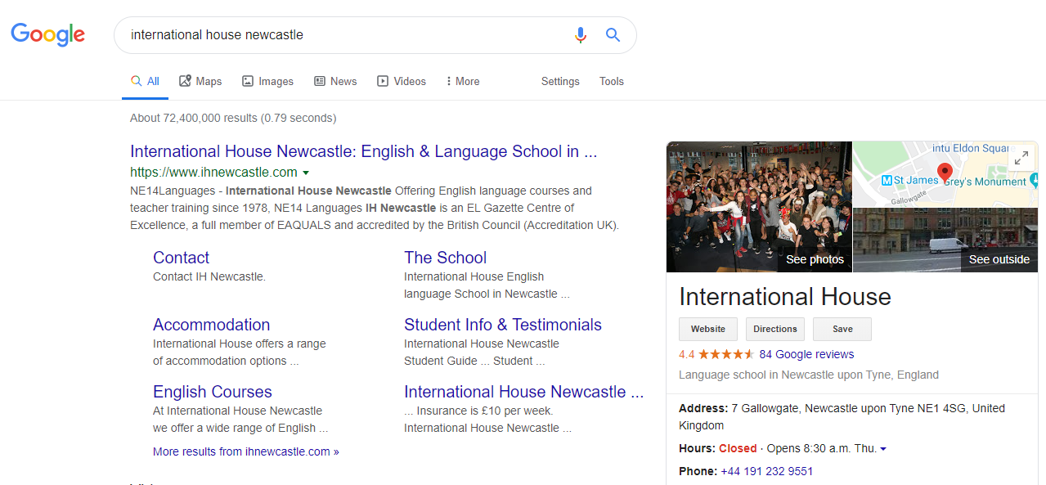
Google Search Engine
Result Page - SERP
Keyword
Google My
Business
Meta
description
Title
Notes:
I’m not sure if we need this

Slide 64
Page Title
Create a descriptive and keyword rich page title
50-70 Characters with no special characters
Avoid duplicate page titles

Slide 65
Heading Tags
Six heading elements, H1 to H6, denote section headline
Include keywords in your header tags
Use only one H1

Slide 66
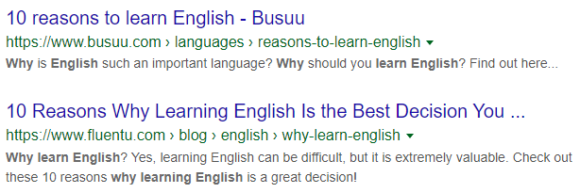
Meta descriptions
Appears on search results pages
Offers a preview of a page’s content
Ideally 155-160 characters
Should include call to action to encourage clicks

Slide 67
Alt & Title Attributes
ALT attribute should describe the graphics without keyword stuffing and spamming
Title attribute should describe the content on the linked page

Slide 68
Exercise 5
On-page
SEO

Slide 69
Measuring Your
SEO Efforts

Slide 70
Measuring your SEO
Efforts Year over Year

Slide 71
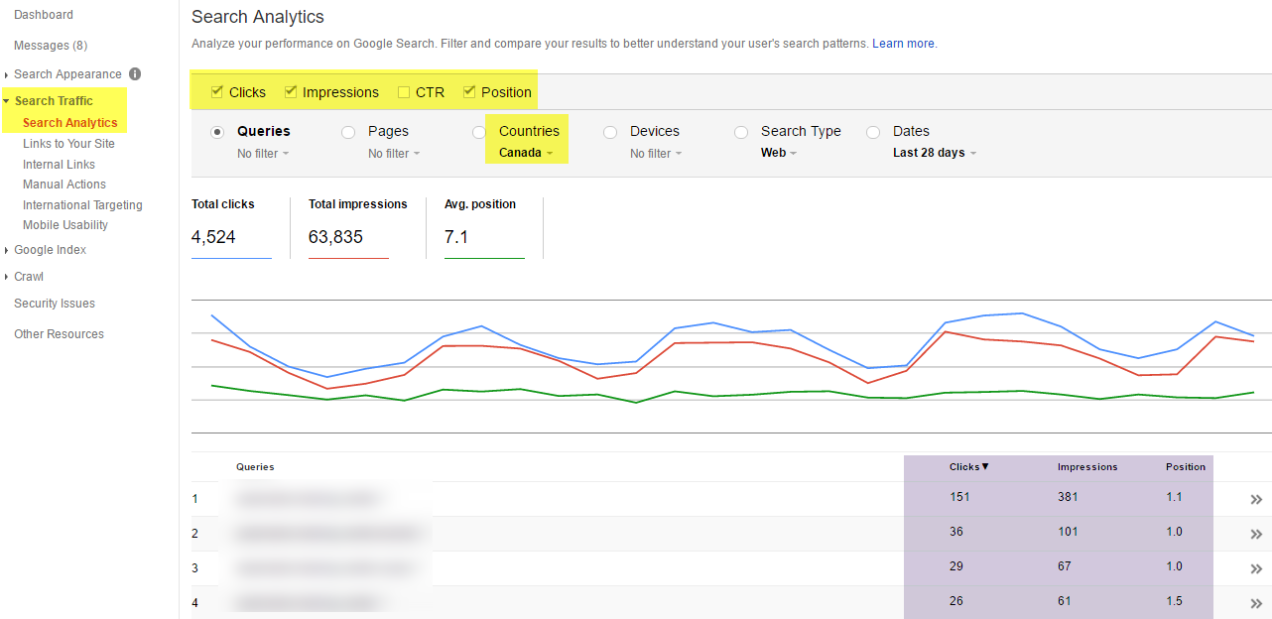
Evaluate your Organic
Search Queries

Slide 72
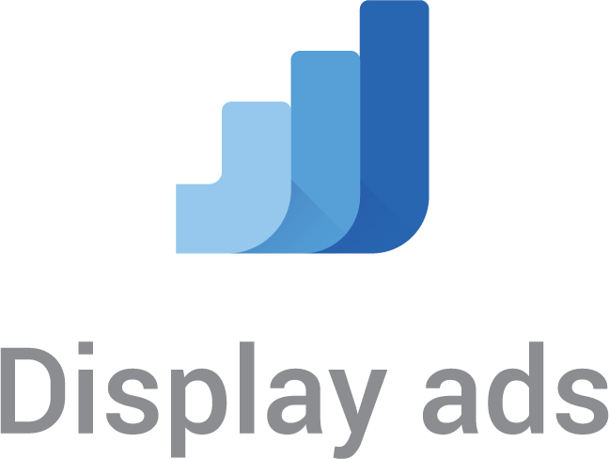
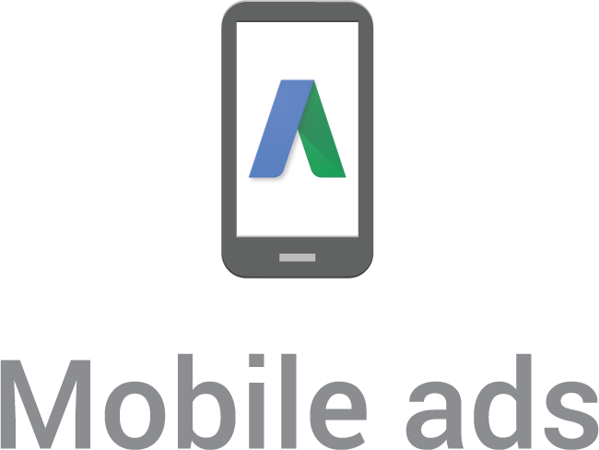
Google Ads

Slide 73
Google Ads Campaign Types

Slide 74
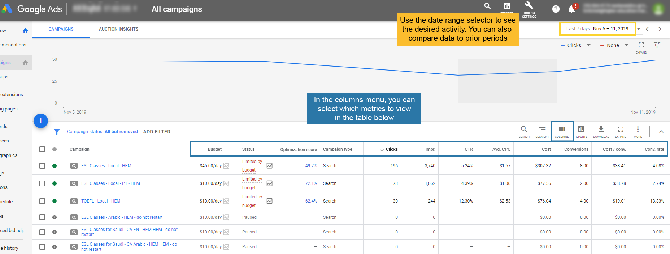
Google Ads Campaign Interface

Slide 75
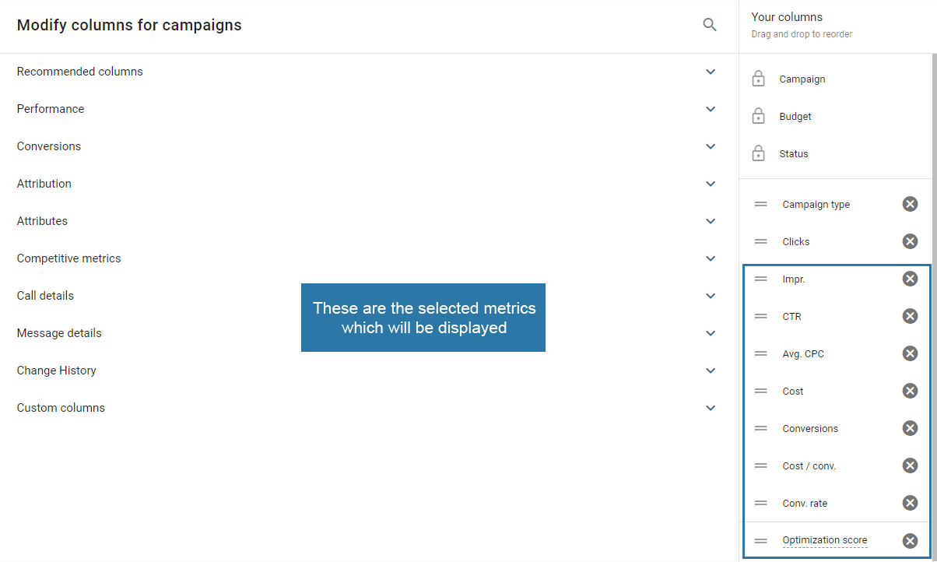
Selecting your metric columns

Slide 76
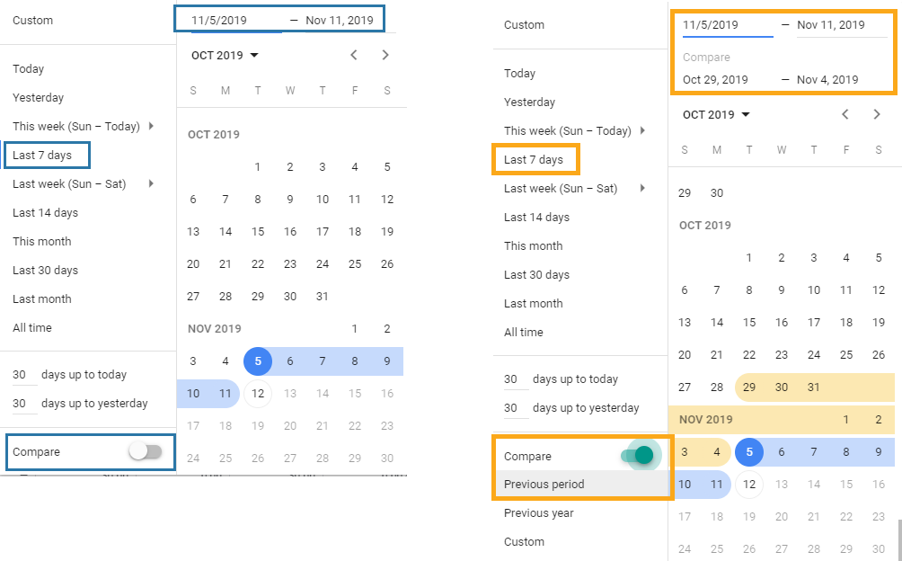
Selecting your date range

Slide 77
Comparing date ranges

Slide 78
Toggling between tabs to drill down in your campaigns

Slide 79
The Ad groups view

Slide 80
The keywords view

Slide 81
Prepare your Google Ads Ad Groups
Organize your keywords semantically to form tight ad groups

Slide 82
Prepare your Google AdWords Text Ads

Slide 83
Use the Google Ads Campaign Template

Slide 84
Google Ads Structure

Slide 85
Exercise 6
Create a Google Ads Campaign

Slide 87
Facebook Ad Campaign Types

Slide 88
Facebook Outcomes:
Conversions vs. Engagement

Slide 89
Creating a Facebook Campaign

Slide 90
Selecting the campaign objective

Slide 91
Select your conversion pixel

Slide 92
Define your Ad Set audience

Slide 93
Name your audience

Slide 94
Use Detailed Targeting

Slide 95
Define your placements

Slide 96
Define your budget

Slide 97
Create Landing Pages

Slide 98
Make your Landing
Pages Responsive
Desktop View
Mobile View

Slide 99
Build your ads

Slide 100
Preview your ads by placement

Slide 101
Preview your ads by placement

Slide 102
Monitor the performance of your ads by placement
Not all placements and devices perform equally

Slide 103
Measure your FB Campaigns in GA

Slide 104
Track Your FB Campaigns in CRM

Slide 105
CRM & Email Marketing for Language Schools
Presented by
Philippe Taza
CEO, Higher Education Marketing

Slide 106
Today’s Presentation
Using CRM to manage inquiries and applications
Segmenting prospects with lead scoring
Create an email workflow
Logging calls and SMS in your CRM
Viewing CRM reports

Slide 107
How can CRM help
Streamline Recruitment?
CRM software offers a range of applications to help you manage your interactions with leads.

Slide 108
How can Marketing
Automation help?
Marketing Automation tools allow you to automate processes and campaigns across multiple channels.

Slide 109
Stages in the Admissions Process
These are the common stages which typical leads and applications go through

Slide 110
Use Lead Capture
Forms

Slide 111
Use form fields to segment your contacts
Info from your forms can be used to automatically enroll leads in specific lists

Slide 112
How can language schools segment leads?
Student’s location
Campus
Native language
Program
Proficiency level
Lead scoring
Previous engagement
Planned course start date
Request Type (Student/Parent/Agent)

Slide 113
Create Unique Forms
for Local Campaigns
You may want to ask specific questions to local leads

Slide 114
Create Unique Forms for International Campaigns
Collect different information for International leads

Slide 115
Define Course of Interest for Segmentation

Slide 116
Specify campus if applicable

Slide 117
Specify campus if applicable

Slide 118
Exercise 7
Form Creation
& Segmentation

Slide 119
Using A CRM To Manage
Prospective Student Inquiries
New leads are entered in the CRM in real time

Slide 120
Separate Applications
from Inquiries
Completed application forms can be automatically sent for processing
Notes:
https://www.inlinguavictoria.com/application/

Slide 121
Separate Applications
from Inquiries
Inquiries may need to be handled by different staff than applications
Notes:
https://www.inlinguavictoria.com/application/

Slide 122
Have The Right Staff
Doing The Follow-Up
Vs.
Mainly processing applications
Taking care of a lead’s every need!

Slide 123
Follow-Up Approach
Making contact with new leads take time! Be persistent with your attempts and contact leads through multiple channels

Slide 124
Use CRM to Rotate
Leads Round Robin
You can use the campus, the program, the country, etc. to define the lead assignment rules.

Slide 125
Create Autoresponders
By Program
The program field determines which auto responder the new lead will get

Slide 126
Create email templates
for common queries
Visa info
Prices
Notes:
Not mad on this visual

Slide 127
Viewing Contacts
on CRM

Slide 128
Record and View Each
Lead’s Contact History

Slide 129
Using a CRM for Calls

Slide 130
Using a CRM for Calls
– Select Outcome

Slide 131
Call Outcome Report
Some CRM Systems give you the ability to monitor phone call volumes and their outcomes.

Slide 132
Sending SMS with CRM
Send SMS Directly from your CRM system

Slide 133
What is Lead Scoring?
Lead Scoring is a methodology that allows you to assign a numeric value to contacts based on actions they take

Slide 134
Lead Scoring Variables
Downloaded a price list or brochure
Country – assign more points for top source countries
When they plan to study?
Demographic info (age, gender etc.)
Engagement with website/email
Different CRMs have different capabilities in this area
Notes:
We could jazz this up a bit by having Jason make icons for each variable

Slide 135
Sample Lead
Scoring Matrix
Parameters | Value
Country of origin | Assign higher scores to student in your main target markets
Gender/Age | Assign higher scores to students that fit your target profile
Program of interest | Assign a higher score once this is known
Email interactions | Add to a student’s score when emails are opened, read, clicked through etc.

Slide 136
Viewing Lead Scoring

Slide 137
Segmenting Your Leads Using Lead Scoring
NEW LEAD
Workflow A
Lives in your local market
Scheduled a level test
Assign High Score
Workflow B
From tier A source countries
Completed info request
Assign Good Score
Workflow C
From tier B source countries
Completed info request
Assign OK Score
Workflow D
From tier C source countries
Downloaded brochure
Assign Low Score

Slide 138
Sample Follow-Up
Workflow
Local lead
Workflow A
Day 1
Day 2
Day 3
Day 4
Day 5
Day 11-30
Day 30+
Attempt call 3 times
(AM, PM, EVE)
Send sms/email
Attempt call 3 times
(AM, PM, EVE)
Send sms/email
Attempt call 3 times
(AM, PM, EVE)
Send sms/email
Attempt call/ send sms/email
Attempt call/ send email
Daily call/ weekly email
Weekly call attempts

Slide 139
Sample Follow-Up
Workflow
High Priority International Lead
Workflow B
Day 1
Day 3
Day 5
Day 7
Day 9
Day 11-30
Day 30+
Attempt call 3 times
(AM, PM, EVE) Send
WhatsApp message/
email
Attempt call/ Send WhatsApp message/
email
Attempt call/ Send email
Attempt call/ Send email
Attempt call/ Send Whatsapp message/
email
Weekly emails/calls
Monthly newsletter

Slide 140
Sample Follow-Up
Workflow
Medium Priority International Lead
Workflow C
Day 1
Day 3
Day 5
Day 7
Day 11-30
Day 30+
Attempt call/ Send email
Send WhatsApp message/ email
Attempt call/ Send email
Send WhatsApp message/
email
Weekly email nurtruing
Monthly newsletter

Slide 141
Sample Follow-up
Workflow
Low Priority Internaitonal Lead
Workflow D
Day 1
Day 7
Monthly
Send email
Send email
Newsletter

Slide 142
Admissions Activity
Report

Slide 143
Exercise 9
Create a Manual Admissions
Workflow

Slide 144
Create Workflows for Follow-up Contact
Workflows can be triggered once a new contact is created in your marketing automation system

Slide 145
Automated Workflow Setup
Use if/then branches to qualify your follow-up activities
Schedule delays between mails to time your workflows

Slide 146
Exercise 8
Create an Automated Email Workflow

Slide 147
Using CRM at
Recruitment Events
Build custom forms for tablets to capture lead info at recruitment fairs

Slide 148
Promoting Webinars
Using CRM
Use CRM to encourage leads to sign up for webinars by creating custom workflows, forms, and landing pages

Slide 149
Webinar Email
Workflow
Invitation 10 days before the event
Confirmation email within 24 hours
Reminder email 1 day before event
WEBINAR
Follow-up email 1 day after event
Registered
Reminder email 4 days before event
Last call email 1 day before event
WEBINAR
Undecided

Slide 150
Leads by Request Type

Slide 151
Leads by Owner

Slide 152
Leads by Request Language

Slide 153
Leads Segmented by Admissions Stage

Slide 154
Enrollments by Contact Owner

Slide 155
Enrollments by Channel

Slide 156
Measure Your Lead to Student Ratio

Slide 157
www.eaquals.org info@eaquals.org @Eaquals #eaquals #eaqualsmembers #eaqualsfamily

